Slide 2
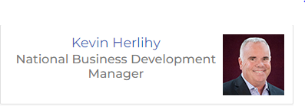
Travel Insured International
We Are Here. Go Be There!

Slide 3
AGENDA
Brand Refresh
Creating an Innovative Modern Brand
Product
Industry Leading Products
Highlights
Covered Cancellation Reasons and Commission Protection
The TII Difference
Support You Can Count On

Slide 4
Purchasing Tools
Online Modification
Simple Quoting
Automated Reminders

Slide 5
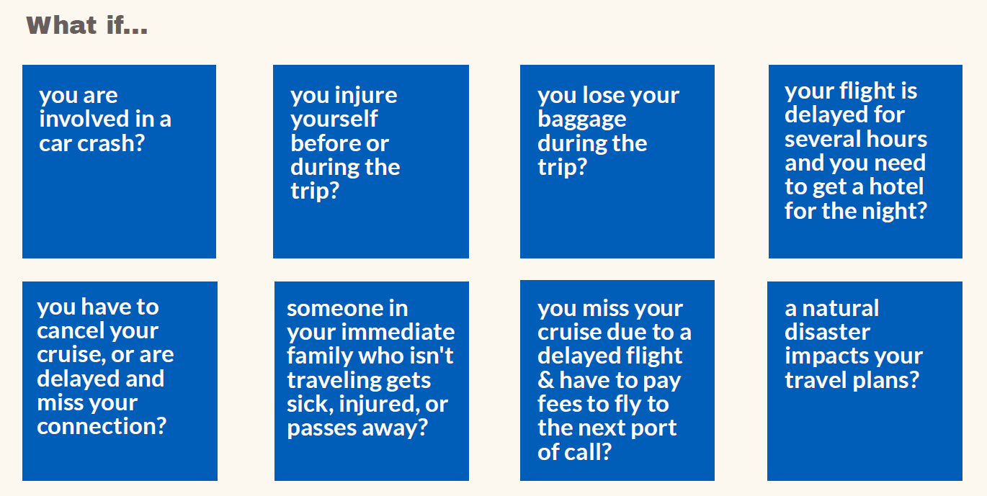
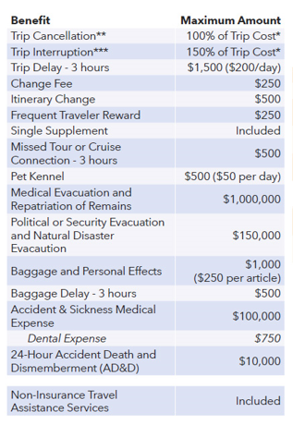
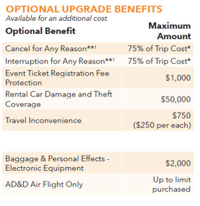
Worldwide Trip Protector
Rates may vary by state
Maximum trip costs: $100kpp/$250k per plan max
Maximum trip duration: 180 days (90 for WA)
Maximum time between purchase and departure date: 3 years
Primary Medical Benefits
Kids 17 and Under are Covered at No Additional Cost
Pre-ex eligibility requires purchase within 21 days of date initial deposit is received (date of deposit is not counted, additional terms apply)
14 day free-look for a plan cost refund

Slide 6
Special Coverages
Work Reasons
Passport / Visa
Hurricane Warning
You or your traveling companion have a transfer of employment, are terminated/laid off, are required to work during the trip, or are involved in a merger or acquisition and must work as a result.
Your or Your Traveling Companion’s passport or visa cannot be issued for a reason beyond Your or Your Traveling Companion’s control. Provided You or Your Traveling Companion have applied at least eight (8) weeks prior to the Scheduled Departure Date or as per the proscribed guidelines from U.S. Department of State.
Is issued within 48 hours of your scheduled departure date for Trip Cancellation, or the warning occurs after your departure for Trip Interruption.

Slide 7
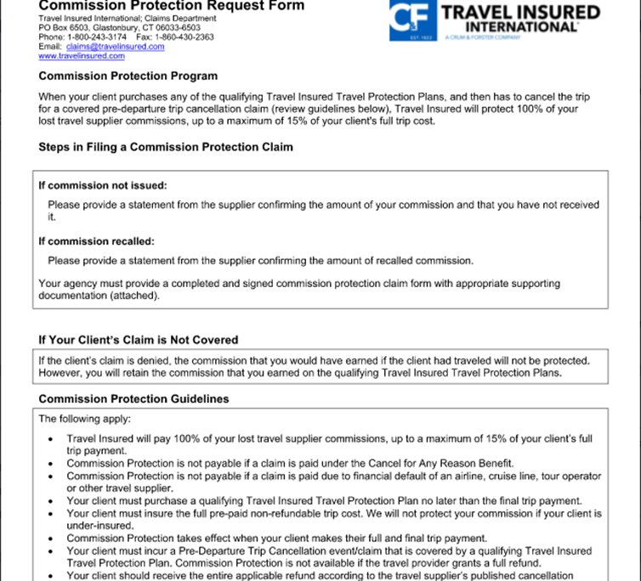
COMMISSION PROTECTION
Protect What You Earn!
When a travel advisor’s client purchases any of the Worldwide Trip Protector plans, and then has to cancel the trip for a covered pre‑departure Trip Cancellation claim, we will protect 100% of the advisor’s lost travel supplier commissions, up to a maximum of 15% of their client's full trip cost.
Commission Protection Form
Access from your Advisor Dashboard or your BDM.

Slide 8
We Are Here. Go Be There!

Slide 9
Travel Insured International
We Are Here. Go Be There!

