Slide 2
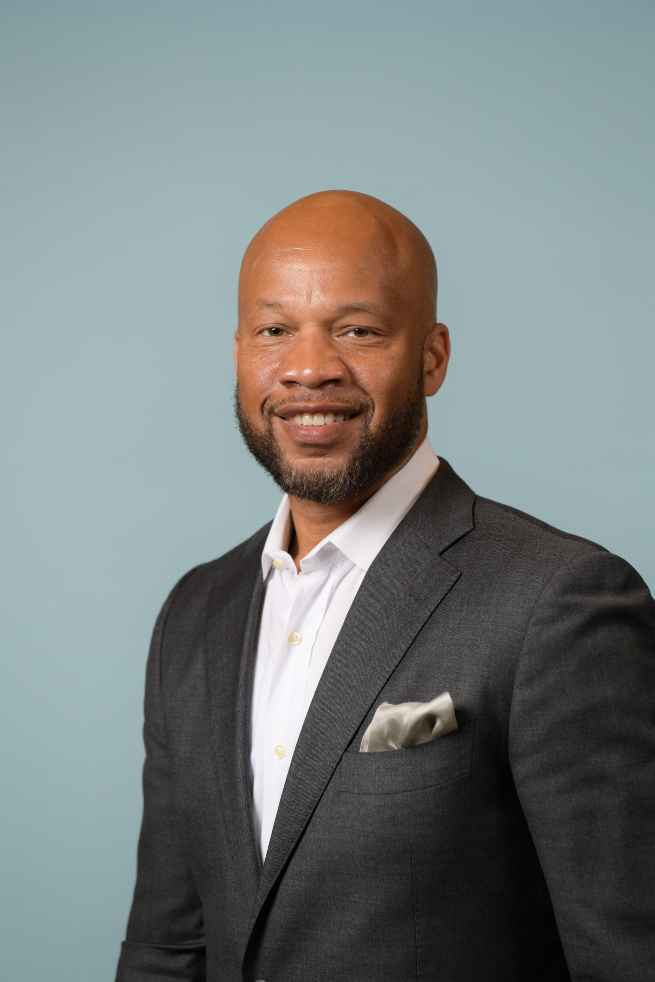
Successful Networking Strategies For The Luxury Advisor
Belvin Baldwin II CEO of Showtime Travel

Slide 3
What is Networking
“the action or process of interacting with others to exchange information and develop professional or social contacts.”
-Dictionary

Slide 4
How Networking Changed my Business
Invited to some of the top sales shows
Made personal contact with top global tourism executives
Interviewed by luxury media outlets
Hosted at major luxury hotels

Slide 5
Proper way to Network
Introduce yourself and what problems you solve
Ask why are you here what’s your purpose
Exchange information (I suggest a social media platform i.e., LinkedIn)
Try to introduce your new contact to someone they may be able to help

Slide 6
Common Networking Mistakes
Not following up
Bad Introduction
Trying to Sale instead of adding value

Slide 7
What are the best places to Network
LinkedIn
Conferences
Trade Shows
Social Events

Slide 8
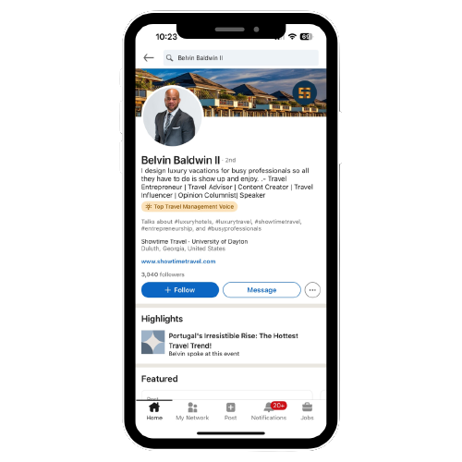
Unleashing LinkedIn
Strong Profile
Explain exactly what you do.
Post should provide value and showcase your expertise. Do not be salesy

Slide 9
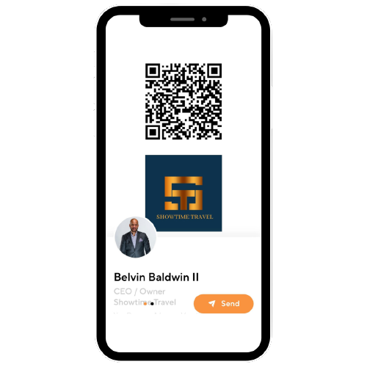
My Gift For You
Connect with me
8 PROVEN STEPS TO MAKING SERIOUS
MONEY AS A TRAVEL ADVISOR!
Also, if you want to step by step how systems has grown my business here is a promo code: ATC2023 you can take advantage of

