Slide 2
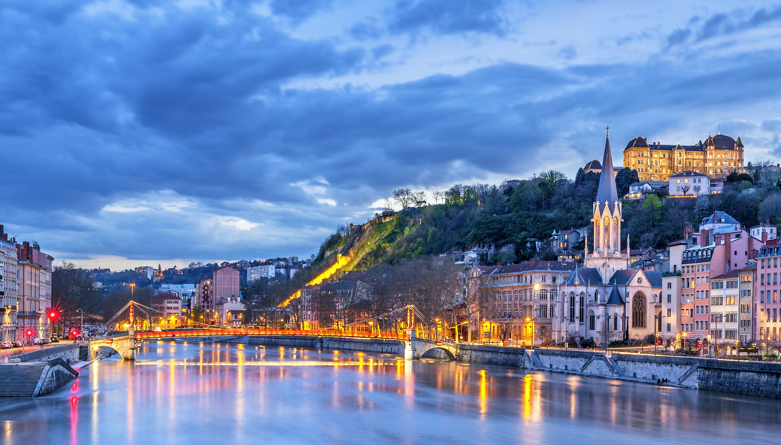


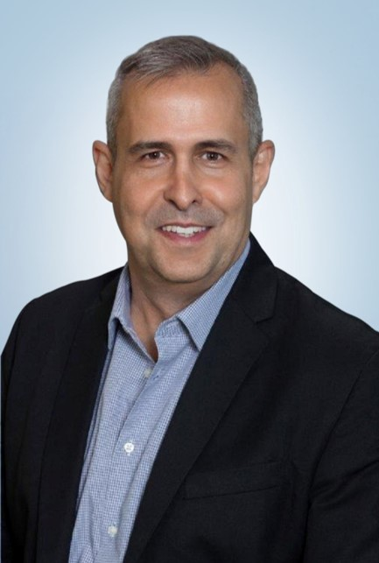
THE LUXURY OF MORE
ALEX PINELO
Senior Vice President, Sales

Slide 3
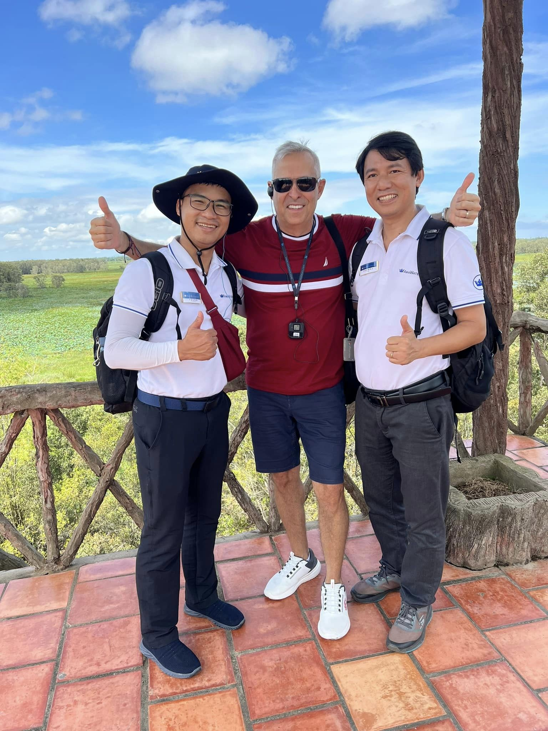


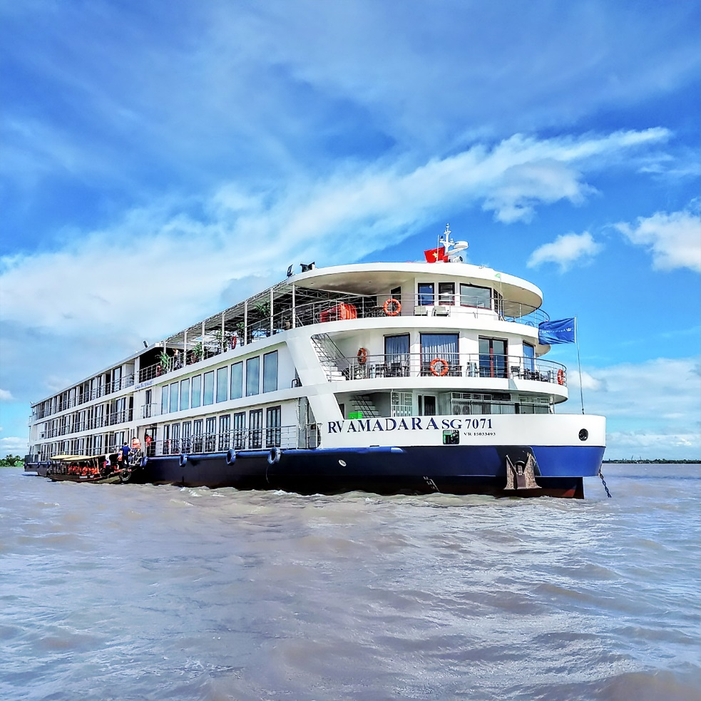
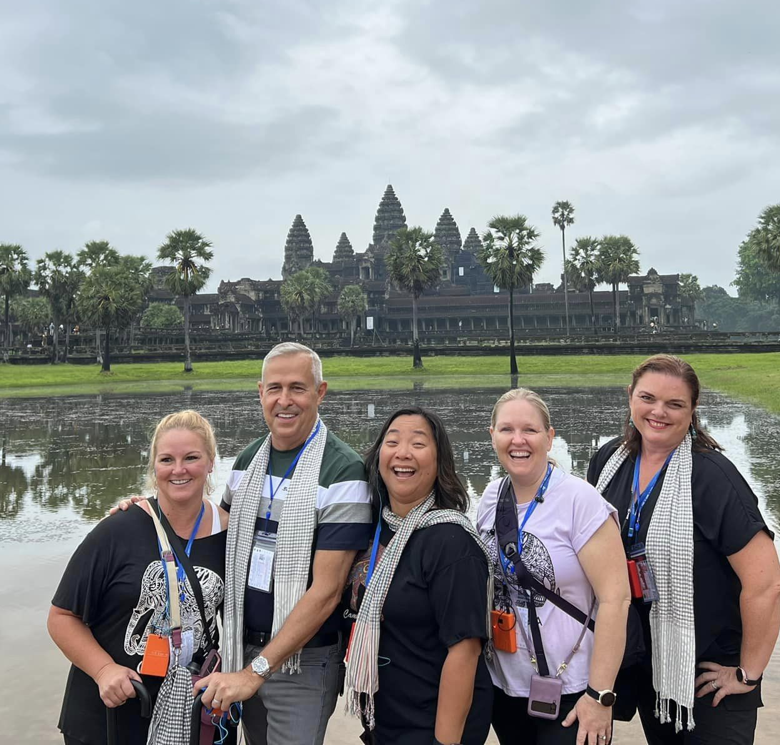

THANK YOU
Notes:
I will start as I will end, and that is by saying THANK YOU!!!
Our partnership with all of you means the world to us, and I must say it is stronger than ever.
Remember at AmaWaterways, we do not have a direct strategy and over 95% of our business comes from you, our valued travel partners. So, without you, there would be no AmaWaterways. You were, you are and will always be our strongest advocates. So again, THANK YOU!!!
It takes a great team to make the dream work and we are blessed to have such an amazing team of professionals and entrepreneurs working closely with each and everyone of you to help you grow your business with us. Our sales and marketing teams are fully staffed and waiting to hear from you.
Also, on behalf of Rudi, Kristin and Gary, myself and the rest of your AmaWaterways family, a huge THANK YOU for all that you have done and continue to do for us and for the industry,
YOU are making a HUGE difference, and we can’t wait to see what the future brings. And remember, we are in this TOGETHER!!! And Together we are stronger, together we are better and together without a doubt, the best is yet to come.

Slide 4
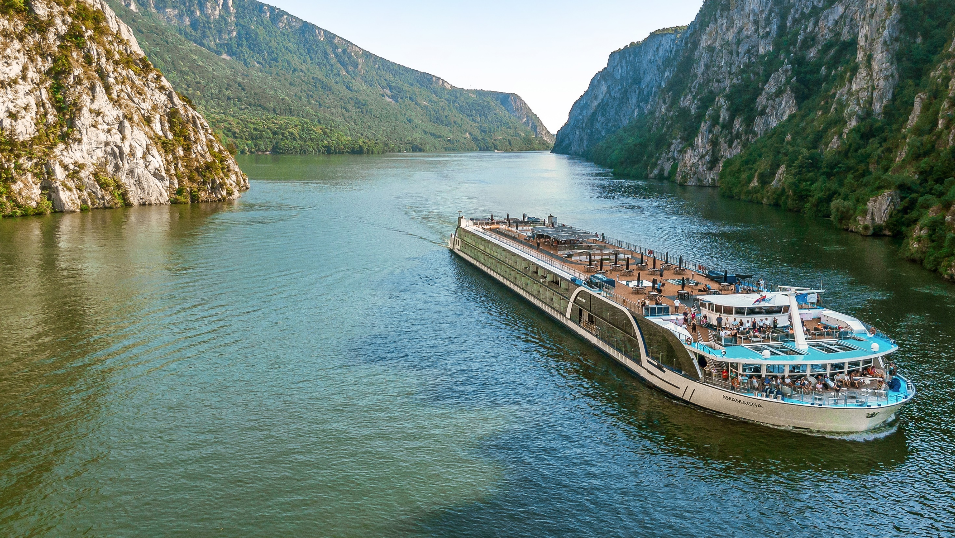

21 YEARS OF
Leading the Way
Notes:
We have been leading the Way for the past 21 years and we can’t wait to see what the next 21 will bring.
While there is not a bad river cruise product, out there, it is important to recognize the differences, and at AmaWaterways, our key differentiator starts with our people, our owners, Rudi, Kristin and Gary and of course our crew on our ships, making our guests feel at home. They are there to bend over backwards to ensure they are exceeding our guests' expectations every step of the way.
We can’t forget our inclusion, yes, we may not be all inclusive, but we are more inclusive providing the luxury of more.
Remember, its not what you pay to get on the ship, but what you pay to get off the ship.
From the quality of our food, to our dedicated wellness hosts onboard, our accommodation and our ships, including the AmaMagna and of course the inclusions, from our all included shore excursions, vs 1 per day, our CM with you on the land portion as well as the cruise, our complimentary wi-fi, we actually spend more money on our wi-fi than on our fuel, and our sparkling wine at breakfast, and unlimited wine and beer during lunch and dinner as well as our sip and sail one hour before dinner. Even our specialty restaurant, The Chef’s Table is included. All our award-winning onboard dining is included, with no buffet service. All meals are prepared fresh a la carte or ala minute.
In addition, our deposit is due 7-days after you make your booking and final payment is due 90 days prior to departure.
We are also very proud of all the accolades and awards we continue to receive. Something we are very proud of and never take for granted.
Thank you for continuing to believe in us and sending your valued clients to us. We promise we will continue to take care of them while creating those customers for life that will be coming back to you time after time.

Slide 5
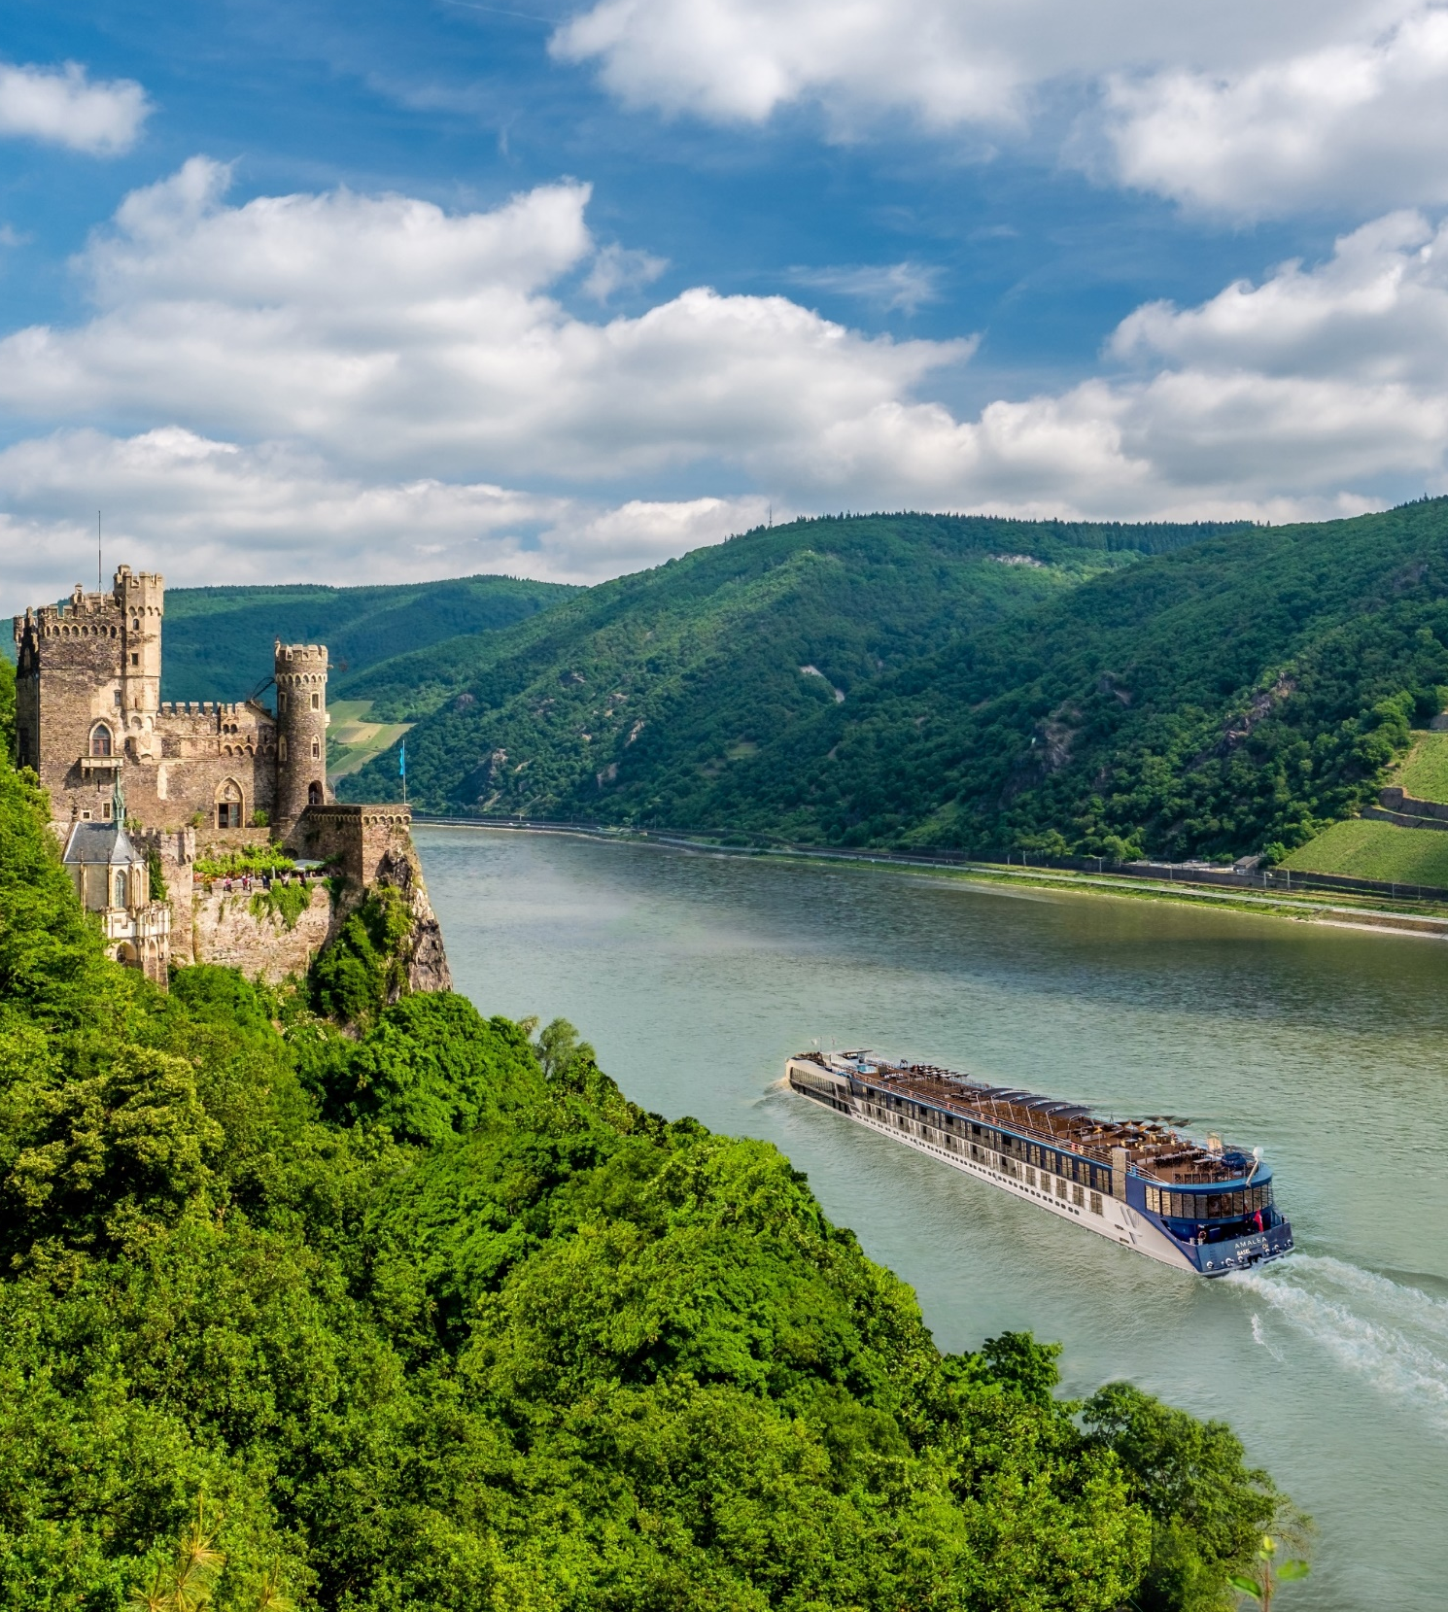
OUR SHIPS
EUROPE
AFRICA
AMACELLO
AMADANTE
AMADOLCE
AMALYRA
AMACERTO
AMAPRIMA
AMAVIDA
AMAREINA
AMASONATA
AMASERENA
AMAVENITA
AMASTELLA
AMAVIOLA
AMAKRISTINA
AMALEA
AMAMAGNA
AMAMORA
AMADOURO
AMALUCIA
AMASIENA
AMABELLA
AMAVERDE
Coming 2025
AMASINTRA
ZAMBEZI QUEEN
EGYPT
AMADAHLIA
Coming 2024
AMALILA
CAMBODIA
& VIETNAM
AMADARA
COLOMBIA
Coming 2024/25
AMAMAGDALENA
AMAMELODIA
AMALEA SAILING THE RHINE GORGE, GERMANY
We Own All Our Ships Debt-Free
Notes:
Here you see our 22 ships in Europe + 1 more coming in 2025
3 in Africa – 2 on the Nile River (1 is currently sailing and 1 is coming in 2024 and 1 on the Chobe River
1 in Vietnam and Cambodia on the Mekong River
And 2 coming in 2024 for Colombia on the Magdalena River

Slide 6
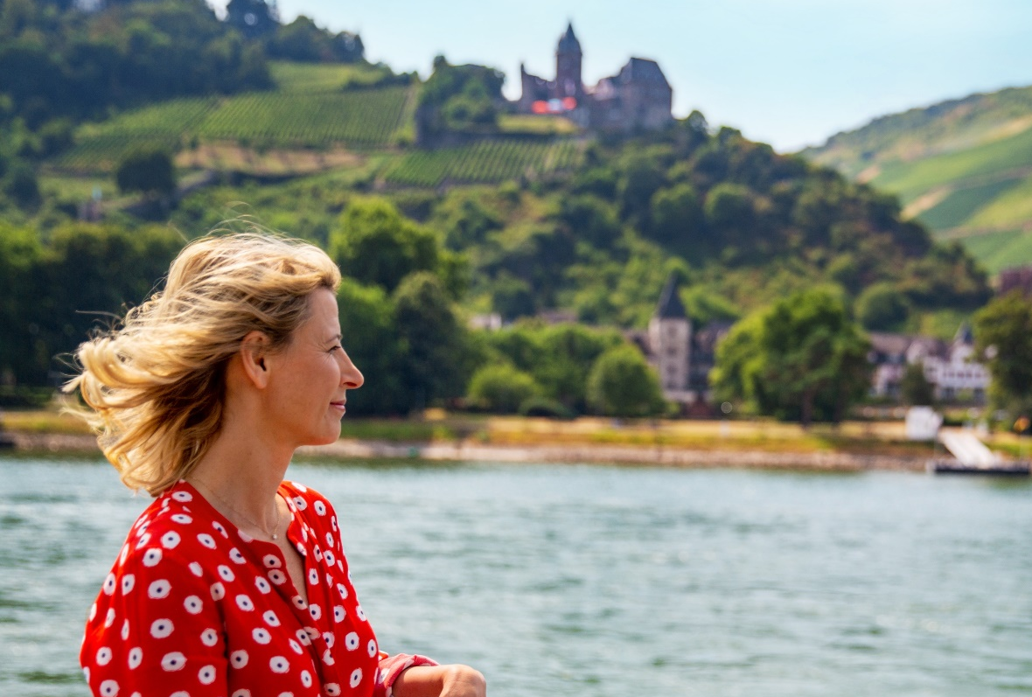
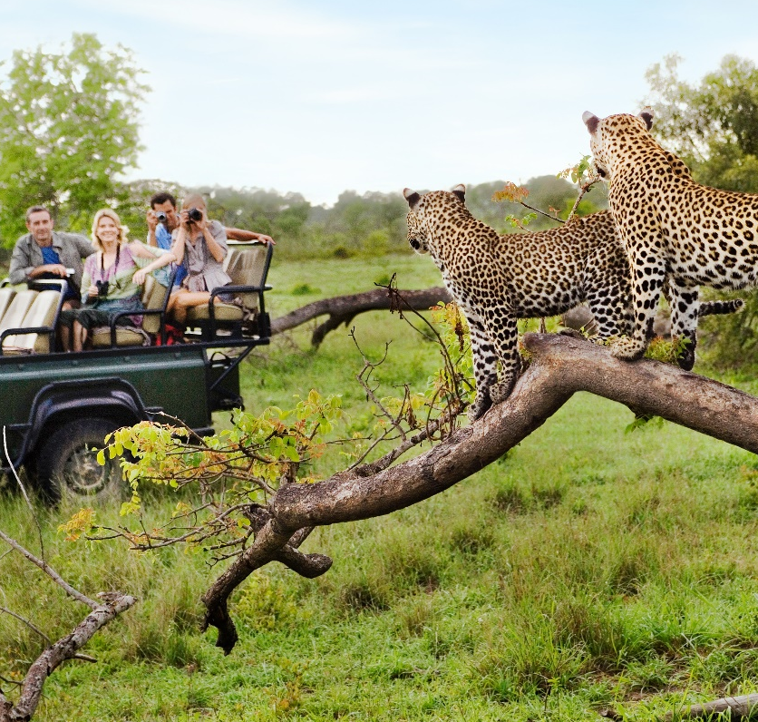

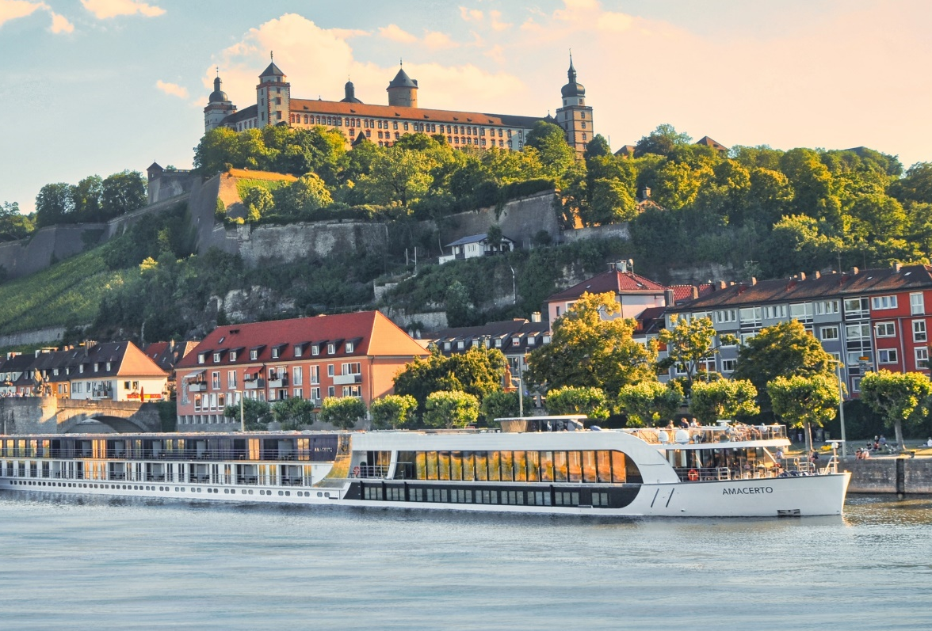
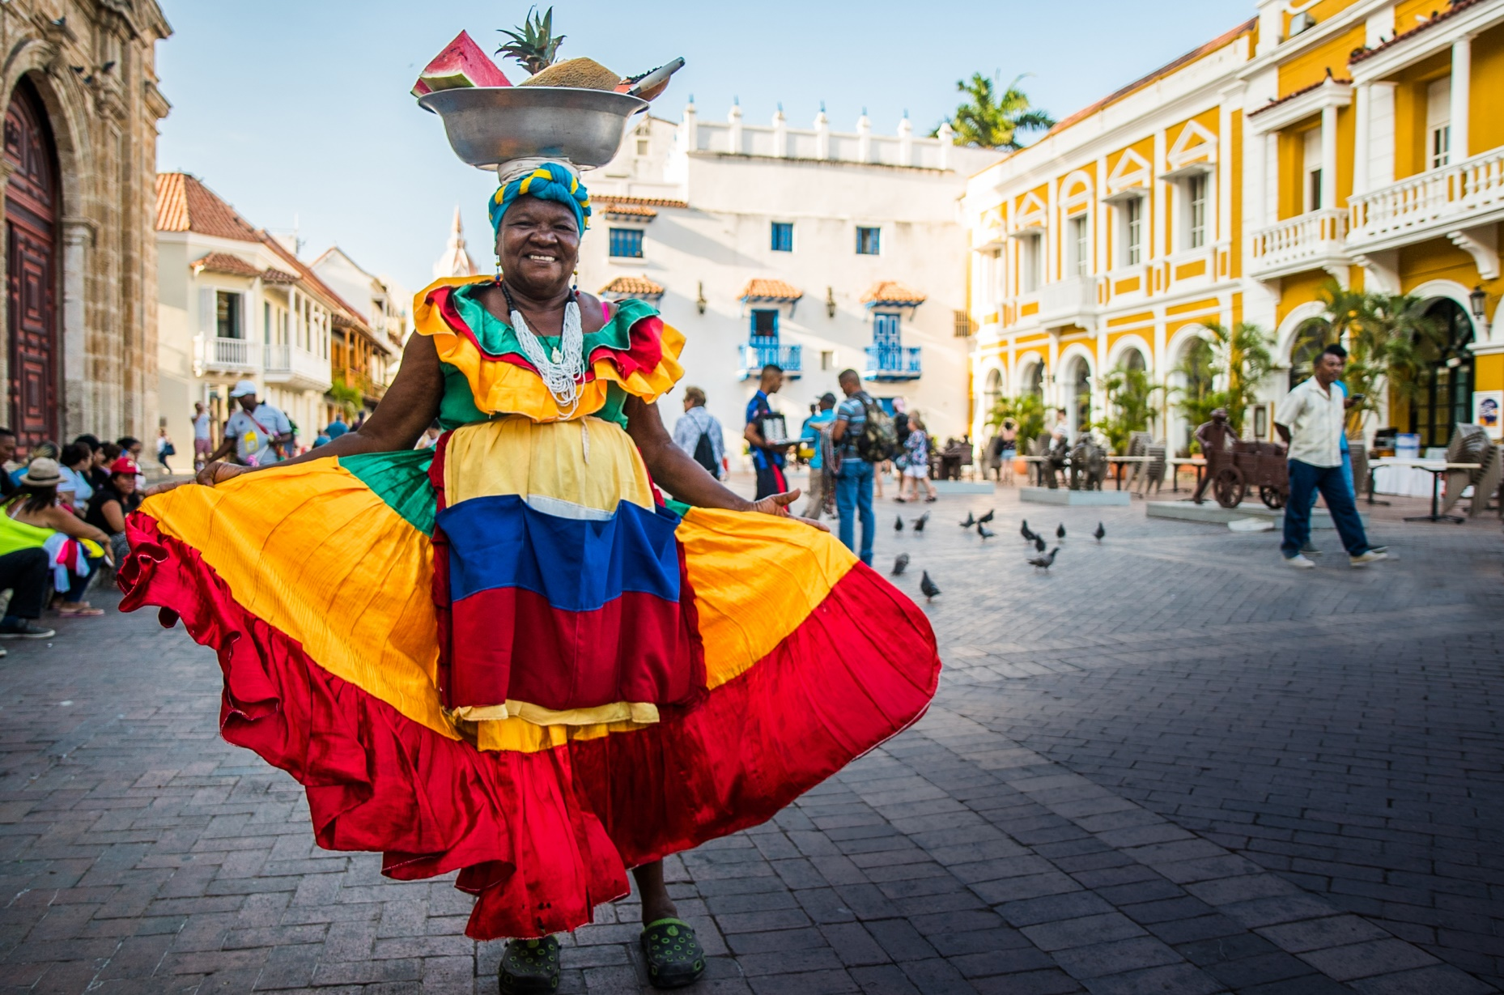
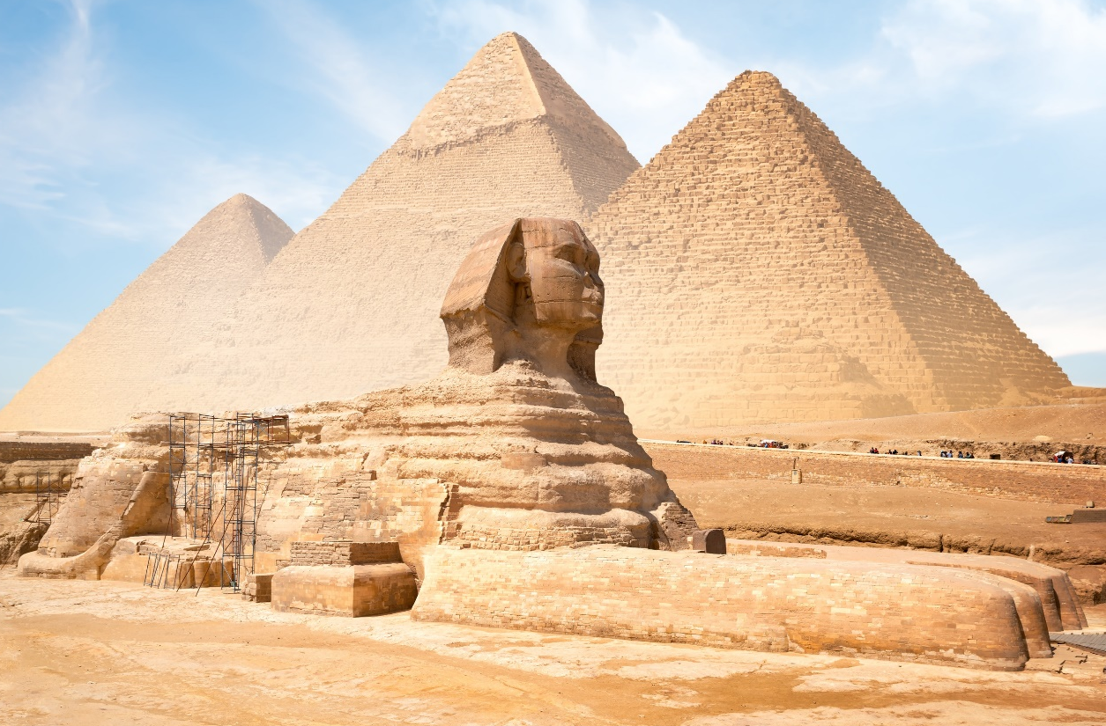
Europe’s
Africa’s
Asia’s
STORIED RIVERS
SAFARIS & WILDLIFE
MEKONG RIVER
Colombia’s MAGDALENA RIVER
Egypt’s NILE RIVER
Notes:
Here you see the world of AmaWaterways:
Starting with Europe We are on the Danube and the Rhine Rivers offering over 20 itineraries on these fascinating rivers.
It also depends on the time of year, as we like to say, there are four seasons on the Danube and Rhine, and depending on when you cruise, you will have a very different and unique experience, and especially during the holidays with the many popular Christmas Markets cruises.
In France, we have 6 different itineraries, on the Seine, the Rhone and the Bordeaux & Burgundy Regions.
In Portugal, we have 2 different itineraries on the Douro River, a roundtrip Porto option and an open jaw Porto to Vega Terron offering a land extension in Madrid.
In total, we have a total of 22 ships in Europe, soon to be 23 with the addition of the AmaSintra in Portugal.
And then our exotics:
On the Mekong visiting Vietnam & Cambodia
On the Chobe River for our Africa Safaris and Wildlife Cruises
And lastly on the Nile with our new Secrets of Egypt & the Nile cruises.
And starting next year, we will start cruising on the Magdalena River in Colombia.
Our beautiful new AmaDahlia started cruising in September of 2021 on her Secrets of Egypt & the Nile itinerary.
36 staterooms carrying only 72 guests
11-night program
Join us on the Nile, the longest river in the world
Cruising on our beautiful AmaDahlia r/t Luxor
3-night pre in Cairo - Four Seasons Residence Hotel in Cairo
7-night cruise on the Nile r/t Luxor
1-night post in Cairo - Four Seasons Residence Hotel in Cairo
3-night pre in Dubai at the Marina Park Hyatt
4-night pre in Jordan
4-night post in Jerusalem at the Waldorf Astoria
We are so excited to being the first to start cruises on the beautiful Magdalena River.
We will have 2 itineraries, our Wonders of Colombia (from Cartagena to Baranquilla), and the Magic of Colombia (from Baranquilla to Cartagena)
We are also offering three amazing land packages in Medellin, Cartagena and Panama City which we will talk about shortly.
The AmaMagdalena will start sailing in March of 2024
30 staterooms / 60 guests
The AmaMelodia will start sailing in April of 2024
32 staterooms / 64 guests
We will have a slight pause of 6 weeks, but we will always have a ship in operation
The perfect ships for a charter, where you can truly customize your experience from start to finish.
As you can see something for everyone, and you are in great hands with Avoya Travel. They will be able to offer you the perfect itinerary of a lifetime that will keep you coming back not only to them but to AmaWaterways.
In Portugal on the Douro River we offer two option, a roundtrip Porto option and an open jaw Porto to Vega Terron offering a land extension in Madrid.
These 2 rivers are our most popular rivers and the perfect options for those first-time cruisers
As you know river cruising offers so many choices and these rivers can be traveled to over and over again and offer a completely different vacation experience every time!
It also depends on the time of year, as we like to say, there are four seasons on the Danube and Rhine, and depending on when you will have a very different and unique experience, and especially during the holidays with the many popular Christmas Markets
Here you can see Budapest in Hungary, the starting and ending point of many of our Danube itineraries.
On the right of the slide, you see the Rhine Gorge, with its crown jewels consisting of more than 40 castles lining its banks
And don’t forget our complimentary land package offer. I will share more details at the end of our presentation.
3-nt Prague (select sailings on the Danube, Main and Rhine rivers)
In France we offer your clients the choice of 5 different itineraries
On the Seine, Rhone, Saone, & Garonne (Bordeaux)
I want to highlight 2 new itineraries in France starting with:
New Impressions of the Seine & Paris on the AmaDante – from Paris to LeHavre or reverse with a pre/post 2-night Paris & a 3-night St. Malo/Mt St. Michel + 1 night Paris
New Essence of Burgundy & Provence on the AmaCello– Chalon Sur Saone to Arles or reverse with a 3-night pre/post in Geneva and a 3-night pre/post in Barcelona
And then the introduction of one of our twin balcony ships, the AmaKristina that moved from the Rhine to the Rhone
Colors of Provence on our beautiful AmaKristina, our only twin balcony ship in France – Lyon to Avignon with a 3-night pre/post in Paris & a 3-night pre/post in Barcelona
And don’t forget our complimentary land package offer on all of our French itineraries with the exception of our Colors of Provence on the AmaKristina. I will share more details at the end of our presentation.
4-nt Basque Country (Taste of Bordeaux)
3-nt St. Malo/Paris (Impressions of the Seine & Paris)
2-nt Paris (Paris & Normandy)
3-nt Barcelona (Essence of Burgundy & Provence)
3-nt Prague (select sailings on the Danube, Main and Rhine rivers)
Starting with:
Paris and Normandy – roundtrip Paris to Paris with a 2-night pre in Paris
Impressions of the Seine & Paris – Paris to LeHavre or reverse with a pre/post 2-night Paris & a 3-night St. Malo/Mt St. Michel + 1 night Paris
Essence of Burgundy & Provence – Chalon Sur Saone to Arles or reverse with a 3-night pre/post in Geneva and a 3-night pre/post in Barcelona
New for 2024 Flavors of Burgundy – Lyon to Dijon or reverse with 3-night pre/post in Geneva Switzerland & a 3-night pre/post in Paris France
Colors of Provence on our beautiful AmaKristina, our only twin balcony ship in France – Lyon to Avignon with a 3-night pre/post in Paris & a 3-night pre/post in Barcelona
Taste of Bordeaux – roundtrip Bordeaux to Bordeaux with a 2-night Bilbao + 2-night San Sebastian and a 2-night pre/post in the Loire Valley + 1-night Paris
In Portugal on the Douro River we offer two option, a roundtrip Porto option and an open jaw Porto to Vega Terron offering a land extension in Madrid.
Our beautiful new AmaDahlia will start cruising in September of 2021 on her Secrets of Egypt & the Nile itinerary.
36 staterooms carrying only 72 guests
11-night program
Join us on the Nile, the longest river in the world
Cruising on our beautiful AmaDahlia r/t Luxor
3-night pre in Cairo - Four Seasons Residence Hotel in Cairo
7-night cruise on the Nile r/t Luxor
1-night post in Cairo - Four Seasons Residence Hotel in Cairo
3-night pre in Dubai at the Marina Park Hyatt
4-night pre in Jordan
4-night post in Jerusalem at the Waldorf Astoria
Four Seasons Residence Hotel in Cairo. 3-nts Pre-cruise in Dubai at the Marina Park Hyatt. 4-nts Pre-cruise in Jordan. 4-nts Post-cruise in Jerusalem at the Waldorf Astoria
Jan-May & Sep-Dec 2021/2022
Egyptians left the most glorious cultural legacy of any ancient civilization, and its magnificent history can be seen and felt along the shores of its legendary river, the Nile, stretching more than four thousand miles. In fact, it is the longest river in the world. The ancient Egyptians settled along the fertile banks of the Nile, establishing one of the world’s most fascinating and evolved civilizations, with a complex belief system, inexplicable rituals, brilliant artistry, ingenious feats of engineering and innovations that changed the course of history. This majestic destination has entranced archaeologists and historians for generations and inspired its own field of study—Egyptology—and now it is time to capture your imagination.
Beautiful cruise on the Nile, the longest river in the world
Cruising on our beautiful AmaDahlia r/t Luxor
For our Exotics we have our Vietnam and Cambodia’s Mekong River
Unleash your inner adventurer as you explore breathtaking Ha Long Bay and Siem Reap, where you'll discover Angkor Wat's awe-inspiring temples. Then cruise along the Mekong to another era, where the rhythms of the countryside allow for fascinating glimpses into a traditional way of life. You will visit rural villages, local workshops and markets, a monastery and two capital cities, conclude your cruise in Ho Chi Minh City, offering a heady mixture of historic and modern delights. 124 guests
Beginning in September 2021, we are thrilled to now take you to a fascinating destination: Egypt. Allow yourself to be treated to a connoisseur’s discovery of this ancient civilization as only AmaWaterways can provide – with an unparalleled 11-night Nile River cruise and land experience that includes exquisite cuisine, authentic experiences onboard the newly redesigned AmaDahlia 72 passengers.
Prepare for the perfect combination of incredible wildlife viewing, culturally rich and historic cities, and an abundance of natural wonders. You enjoy a four-night Chobe River safari cruise. Roam among the gentle giants at Chobe National Park and then travel to Victoria Falls to soak up the sights and sounds of one of the world’s largest waterfalls for two nights.
Latin Touch – AmaKristina 10/26/23
Soulful Epicurean – AmaKristina 8/24/23
AmaKristina 6/13/24 & 6/17/24
AmaDahlia 5/17/24

Slide 7

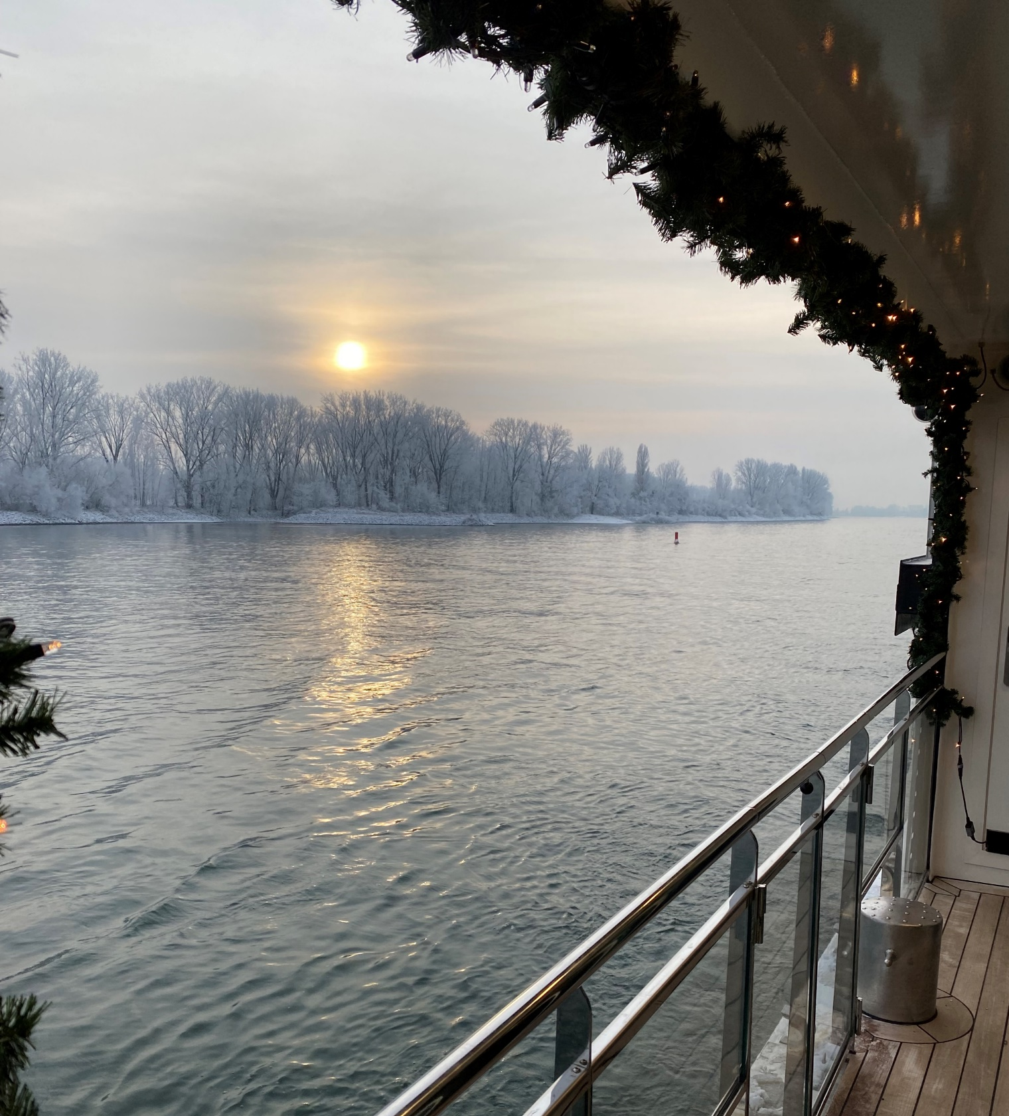

2024 SEASON EXTENSION
AmaMagna & AmaLucia
AmaMagna, Magna on the Danube
February 11
February 18
February 25
AmaLucia, Captivating Rhine
February 11
February 25
AmaLucia, Enchanting Rhine
February 18

Slide 8
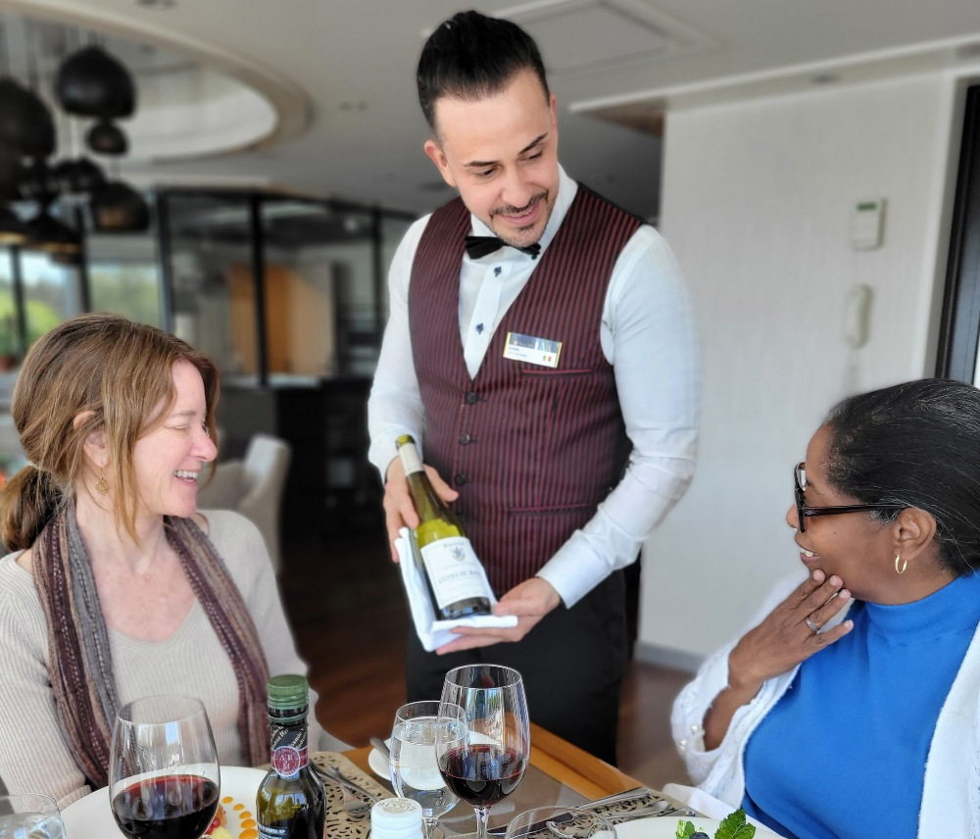
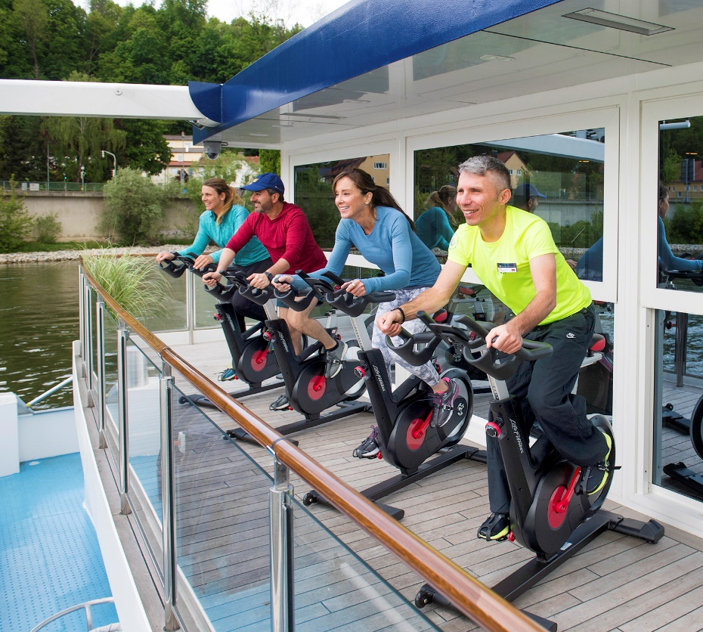
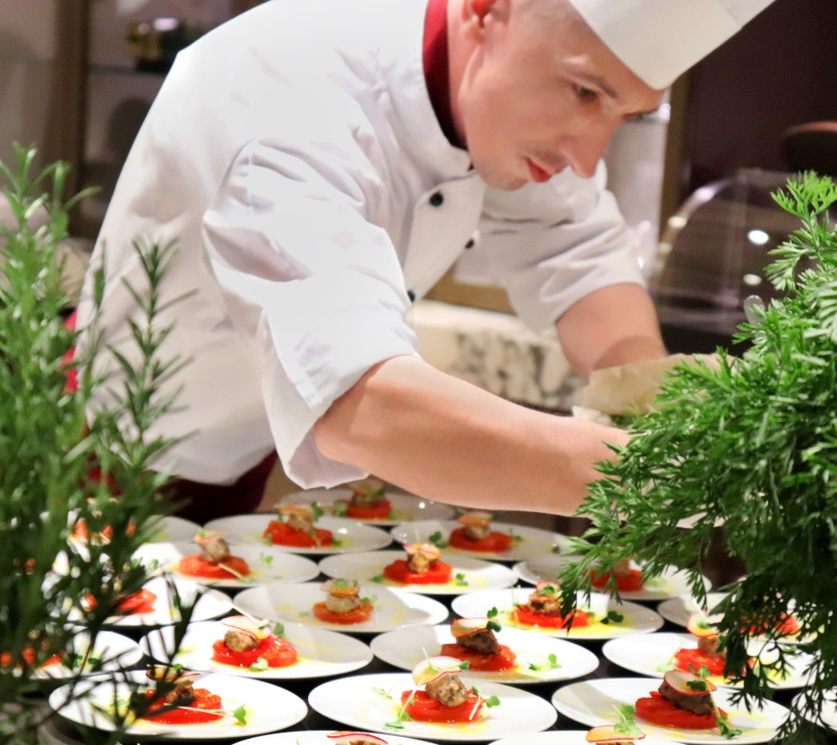
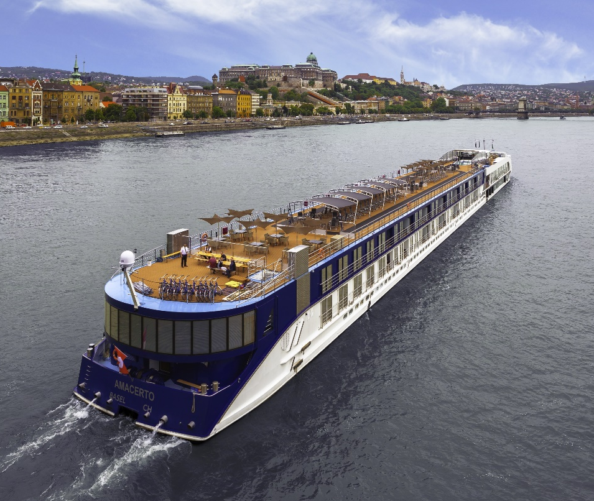
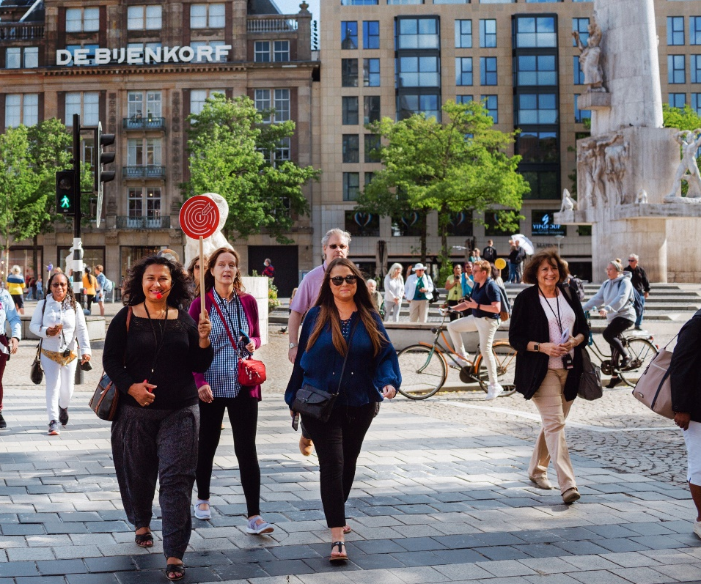
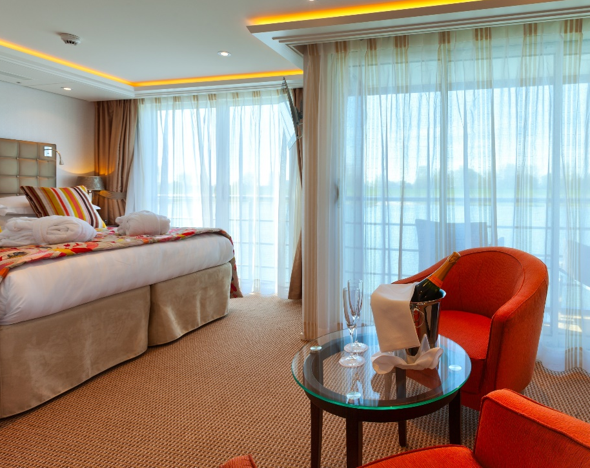
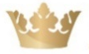
THE AMAWATERWAYS DIFFERENCE
Notes:
From top left to bottom right:
-Wellness Program
-Fine Cuisine
-Sip & Sail cocktail hour
-Excursions in every port
-Luxury ships
-Spacious staterooms

Slide 9
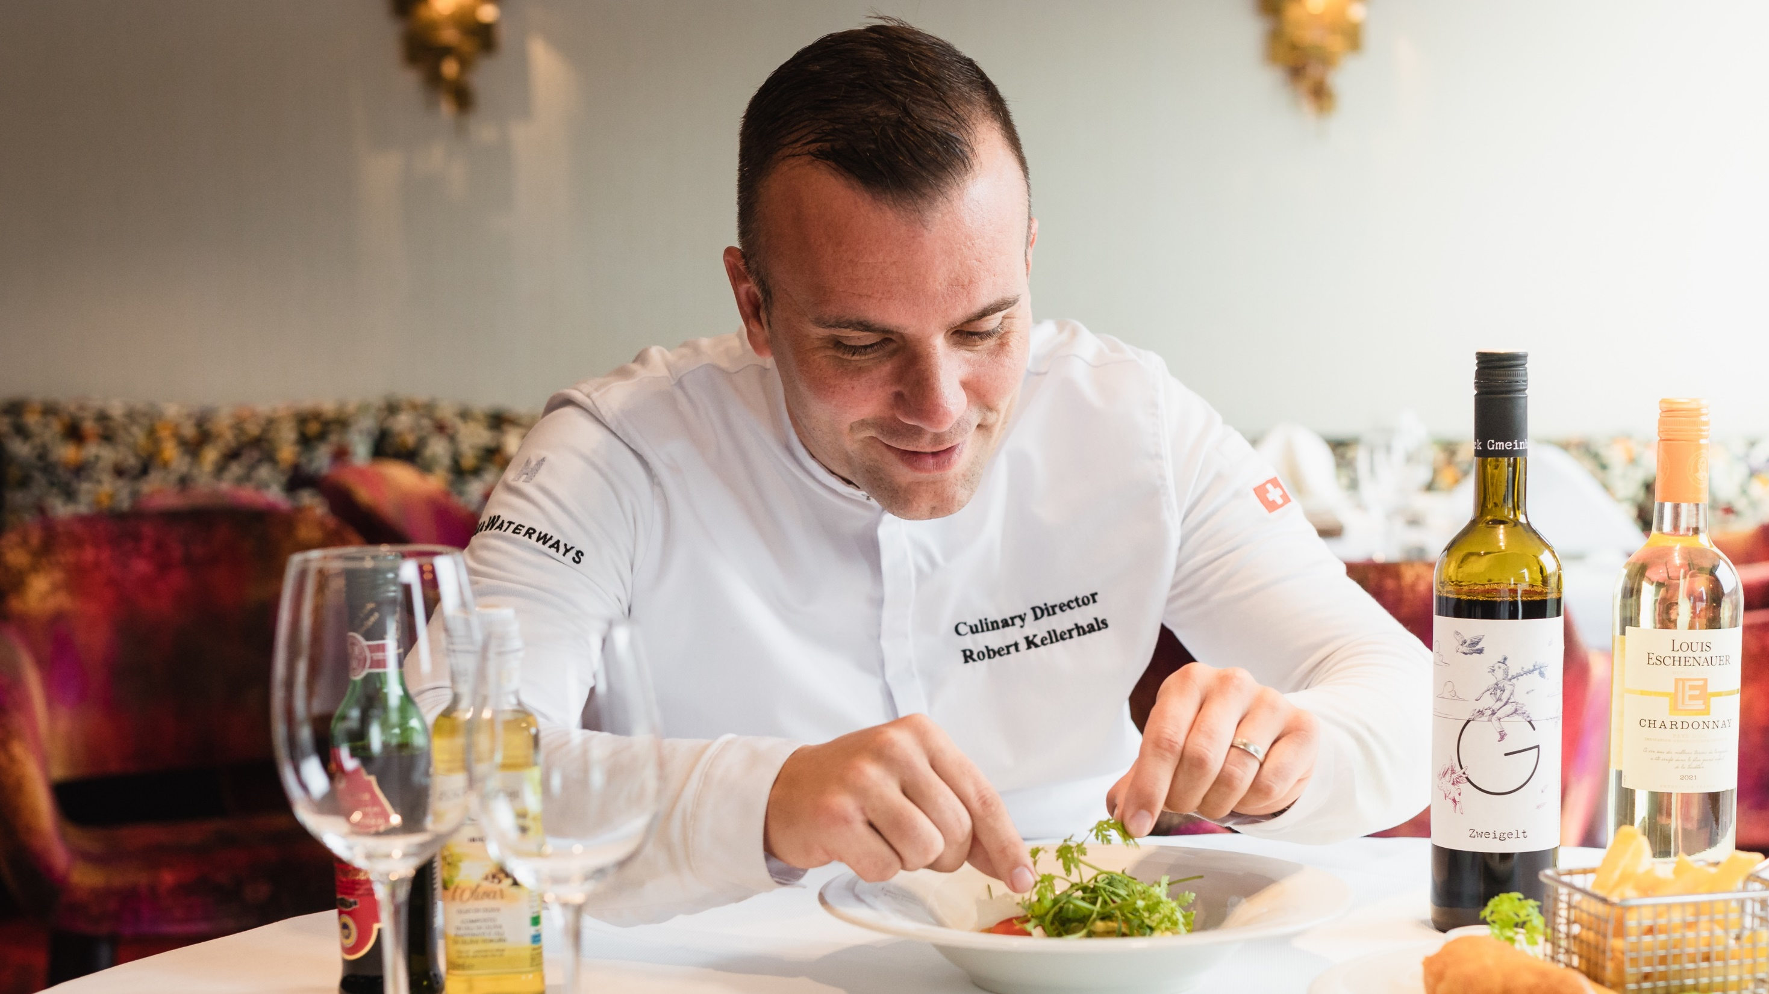


AWARD-WINNING
Cuisine
Notes:
Our award-winning cuisine is truly an extension of the destinations we sail through
All onboard dining is included
Locally sourced
No large freezers onboard
Our European ships have all been awarded with membership to
La Chaîne des Rôtisseurs
and
Tables et Auberges de France
As a result, we have the best food offering on the rivers and we have received the most accolades and awards in this category.
Also don’t forget our Celebration of Wine Cruises with over 70 to choose from

Slide 10
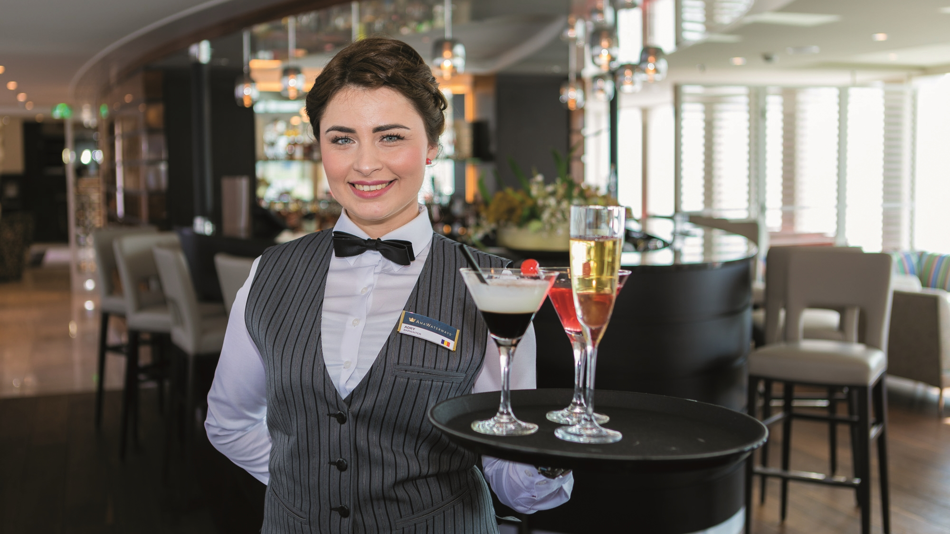
Sip & Sail
COMPLIMENTARY COCKTAIL HOUR
Fine Wines Included with Lunch & Dinner
Notes:
In addition to the complimentary unlimited sparkling wine and champagne during breakfast to our fine local regional wines and beer during lunch and dinner, we also have a complimentary 1-hour sip and sail or cocktail hour offering unlimited drinks prior to dinner.

Slide 11

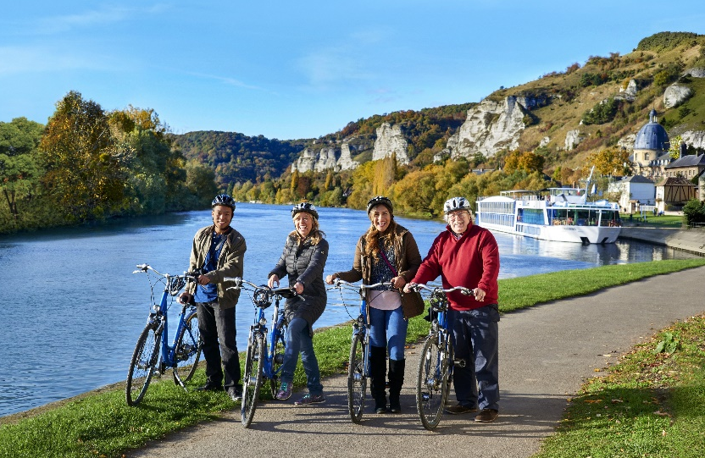
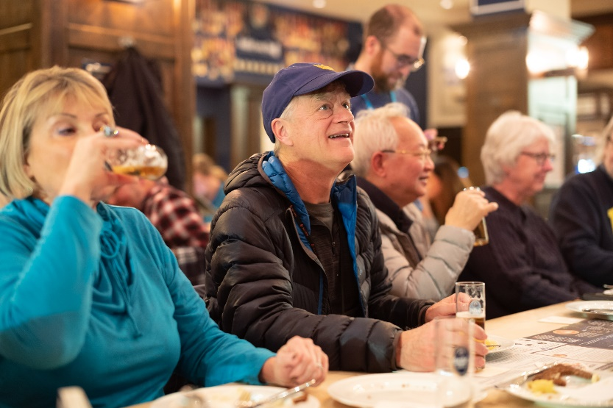
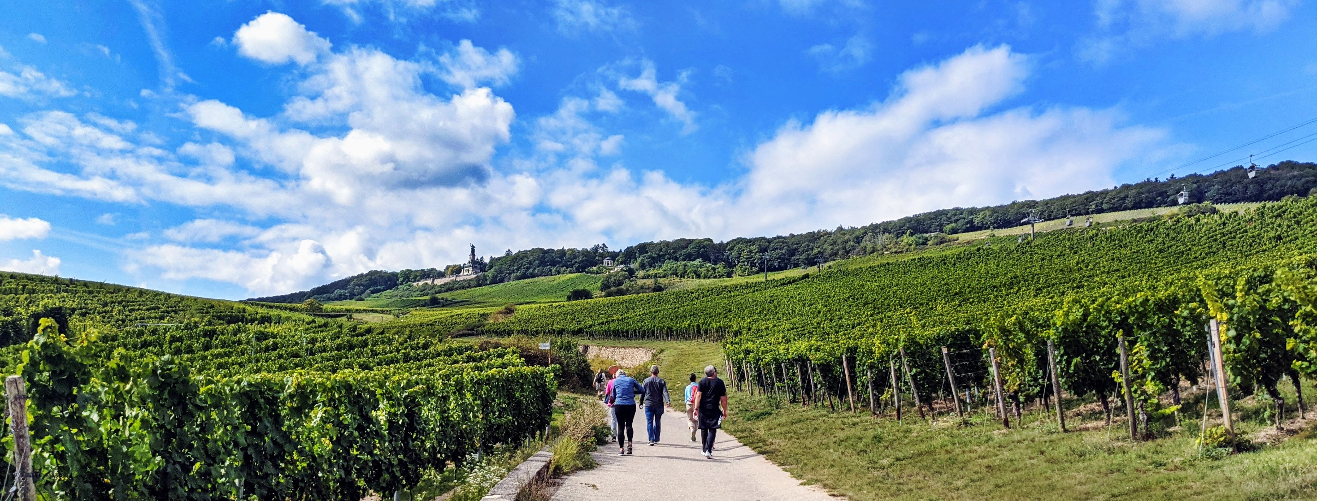
A VARIETY OF INCLUDED
Shore Excursions
Notes:
While some of our competitors include only 1 per day
We include them all
With up to 20 tours included in a 7-night river cruise, there is so much choice to keep every member of the family happy.
Our included shore excursions offer a variety of choices each day that are personalized to every kind of traveler
Your Choice:
Walking Tours: Gentle, Regular and Active
Guided Hiking Tours
Guided Biking Tours
Special Interest Tours
Late Riser Tours

Slide 12
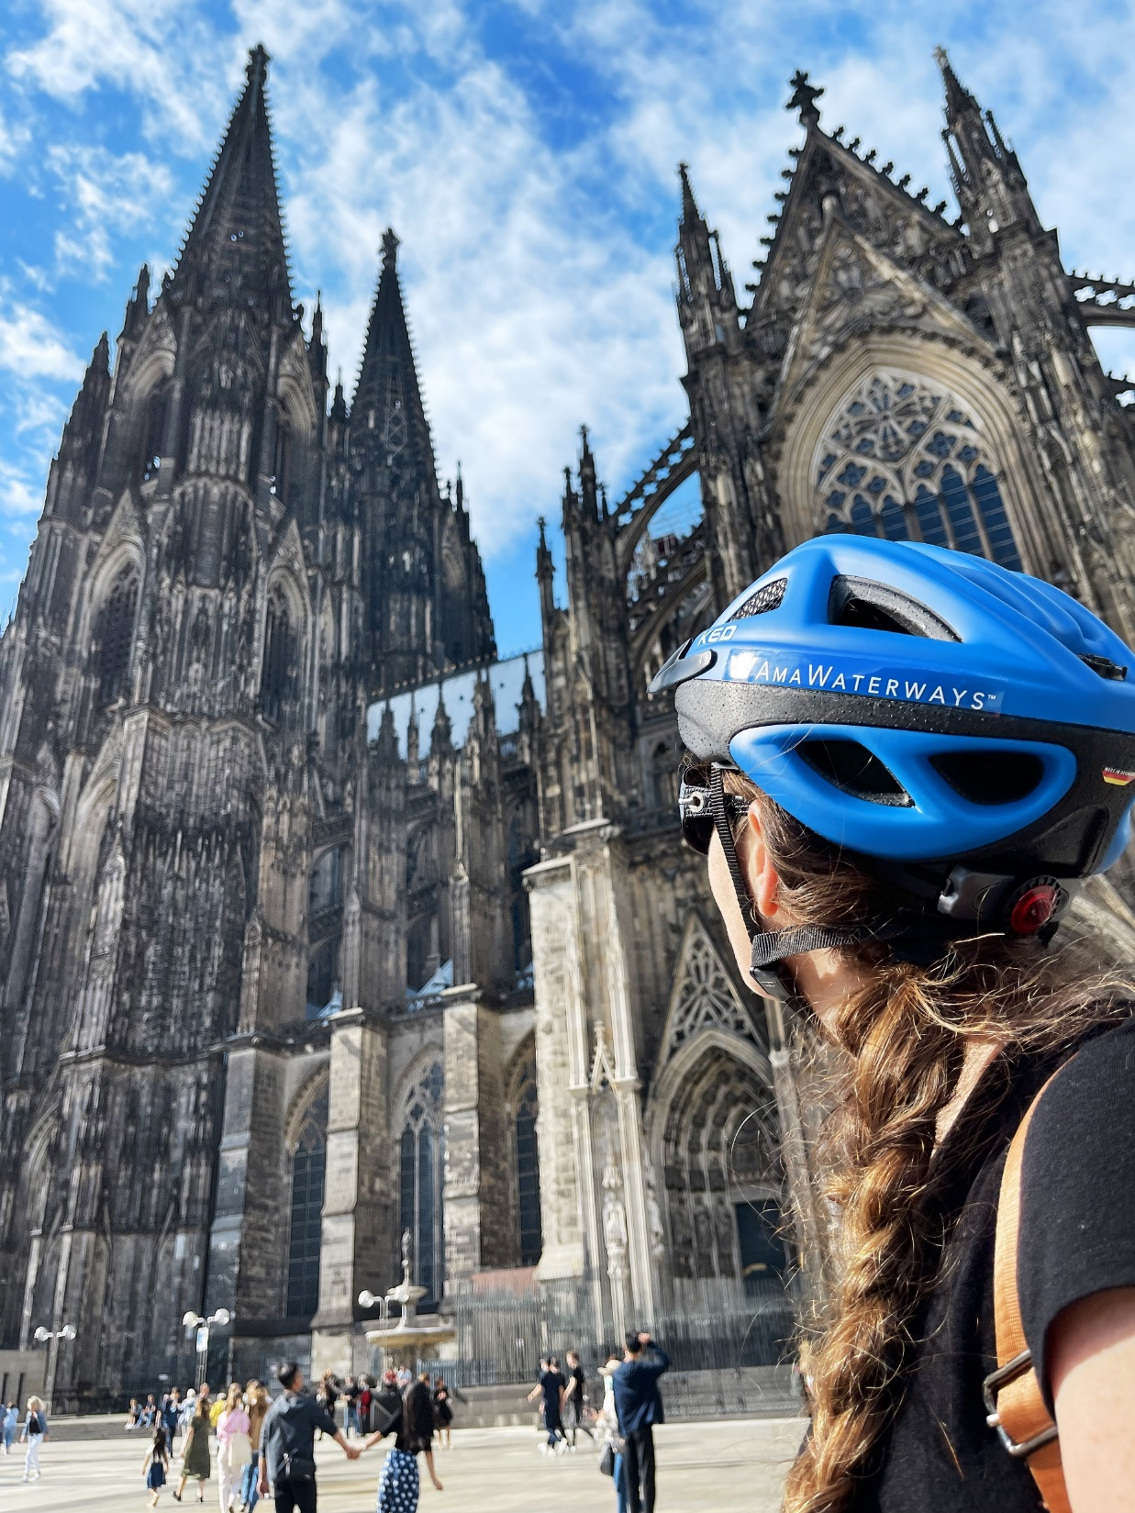
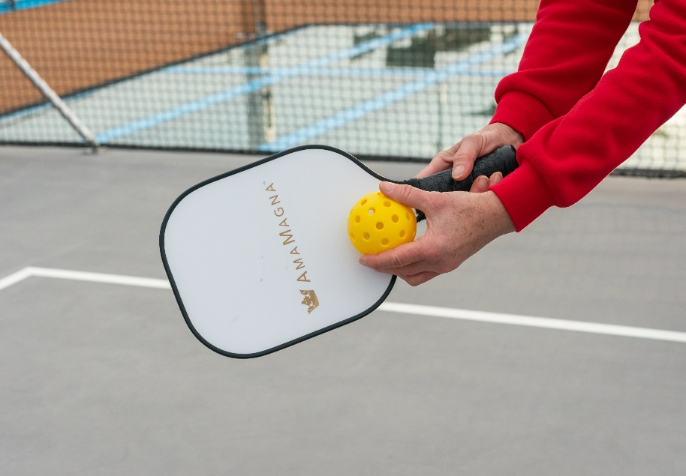
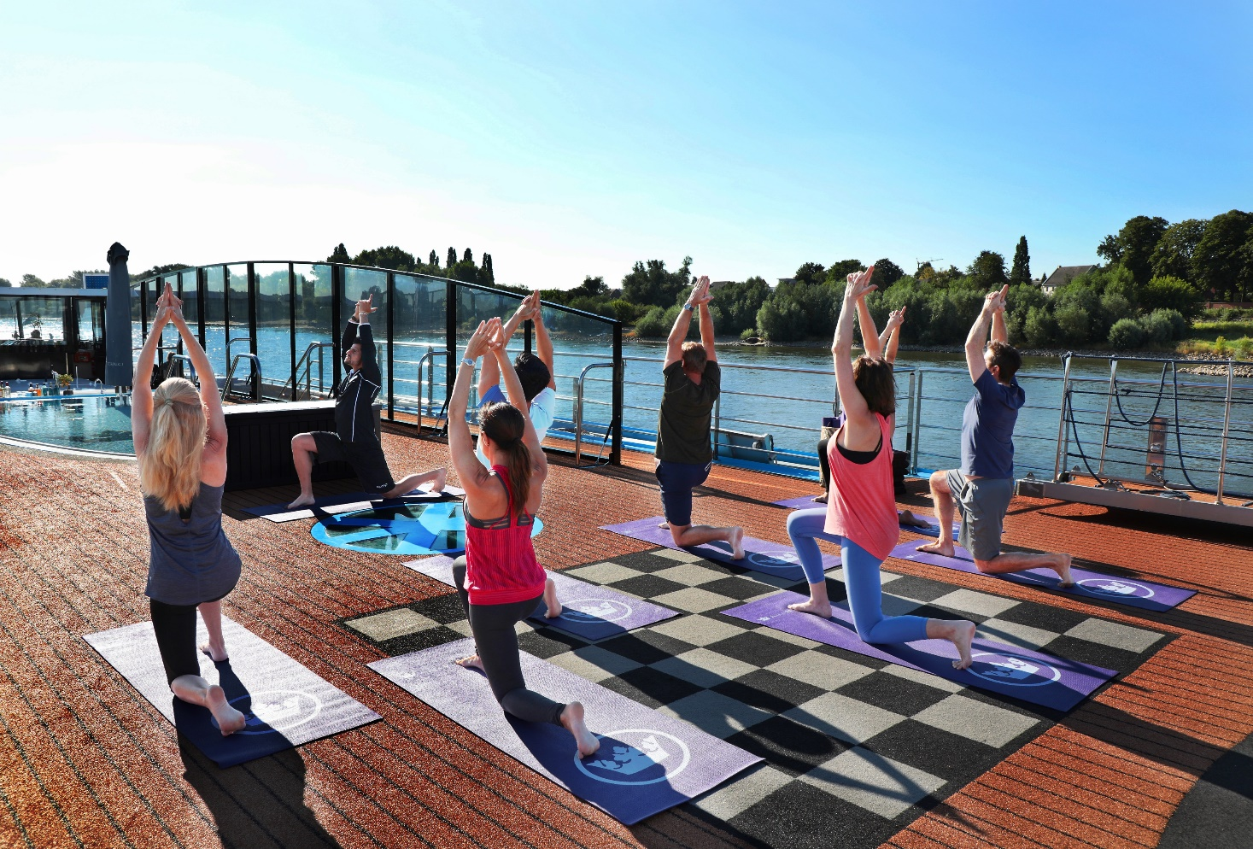
DEDICATED
Wellness Program
Notes:
Our wellness program is very popular amongst our guest
AmaWaterways was the first
river cruise line to offer a dedicated
Wellness Host on board
They will have exercise classes every morning from stretch to core strengthening to my favorite champagne yoga.
We also now have Pickle Ball on the AmaMagna
And of course all the hiking and biking options throughout the week

Slide 13
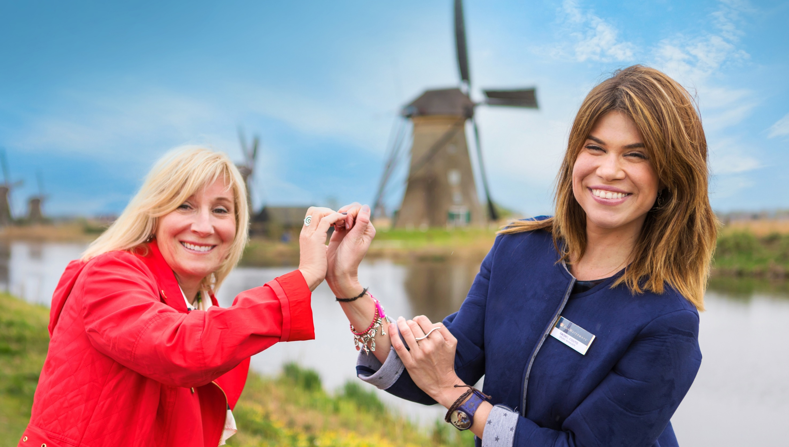
THE HEART OF AMAWATERWAYS IS
People
Our
Notes:
As beautiful as our ships are, our hardware, it is our people or our software that truly stand out and make a difference differentiating us from our competitors.
AmaWaterways' crew always goes above and beyond to ensure you and your clients have a most memorable experience. They are continuously trained to ensure they always exceed expectations through many surprises and delights and their flexibility to change and adapt to a variety of scenarios without negatively impacting the guests' experience is impeccable.
For those of you that have sailed with us, you know exactly what I am refereeing to.
Not only do you have access to our Sales Team…Marketing, Res, Air, Ops, IT and so much more.

Slide 14
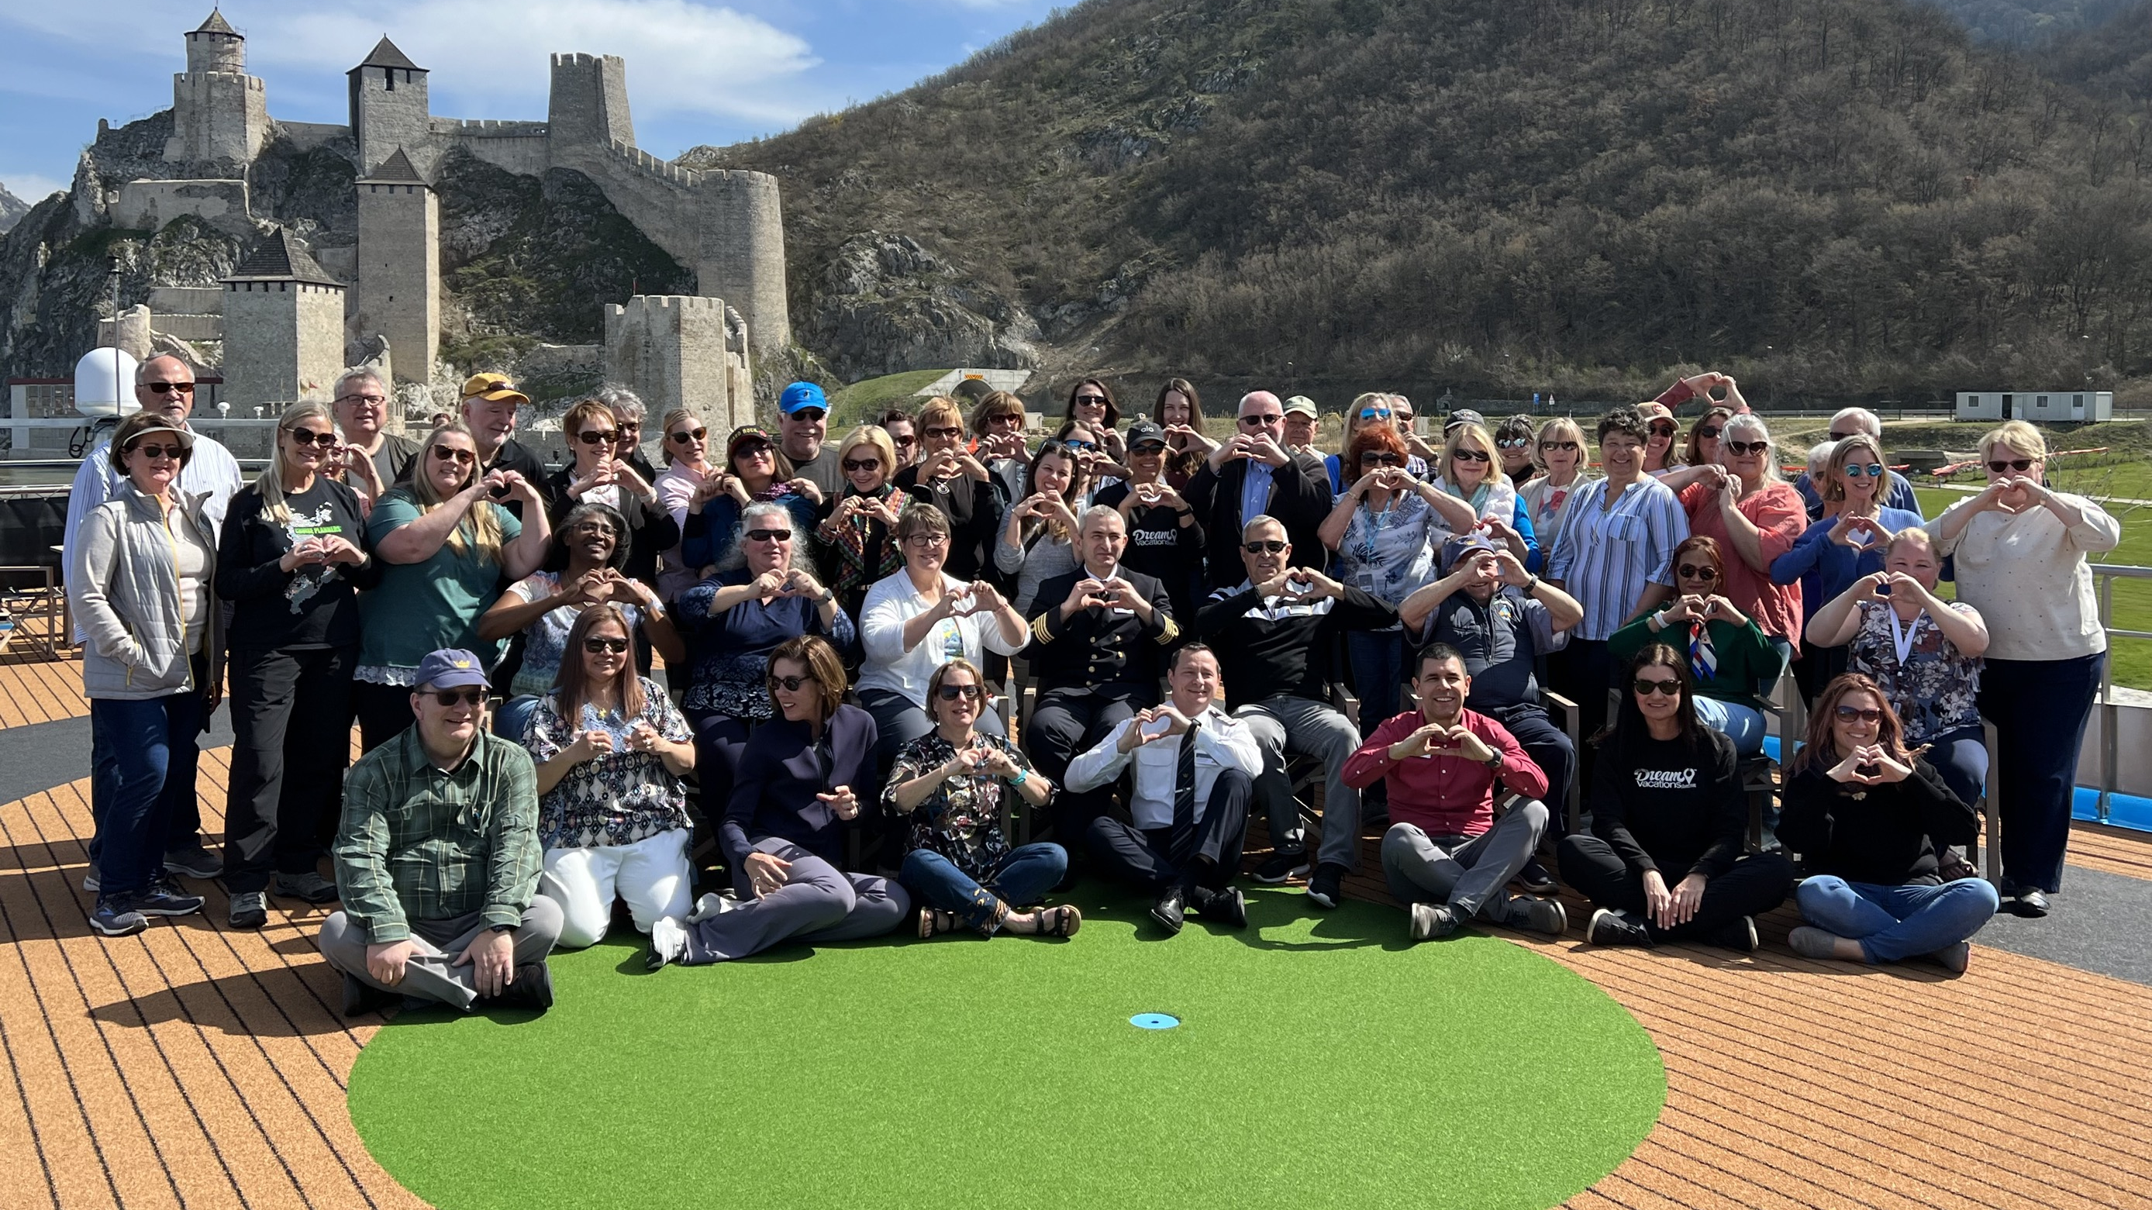
Partners
THE HEART OF AMAWATERWAYS IS
Our
Notes:
And of course, we would not be where we are today without you. Some companies make their decisions based on how they can put an extra buck in their pocket. We make our decisions based on how we can provide better support to you, our valued travel partners, and how we can provide a better guest experience for our guests and your clients.
We can’t wait to see what the future will bring for us, for you and for your clients and out guests.

Slide 15
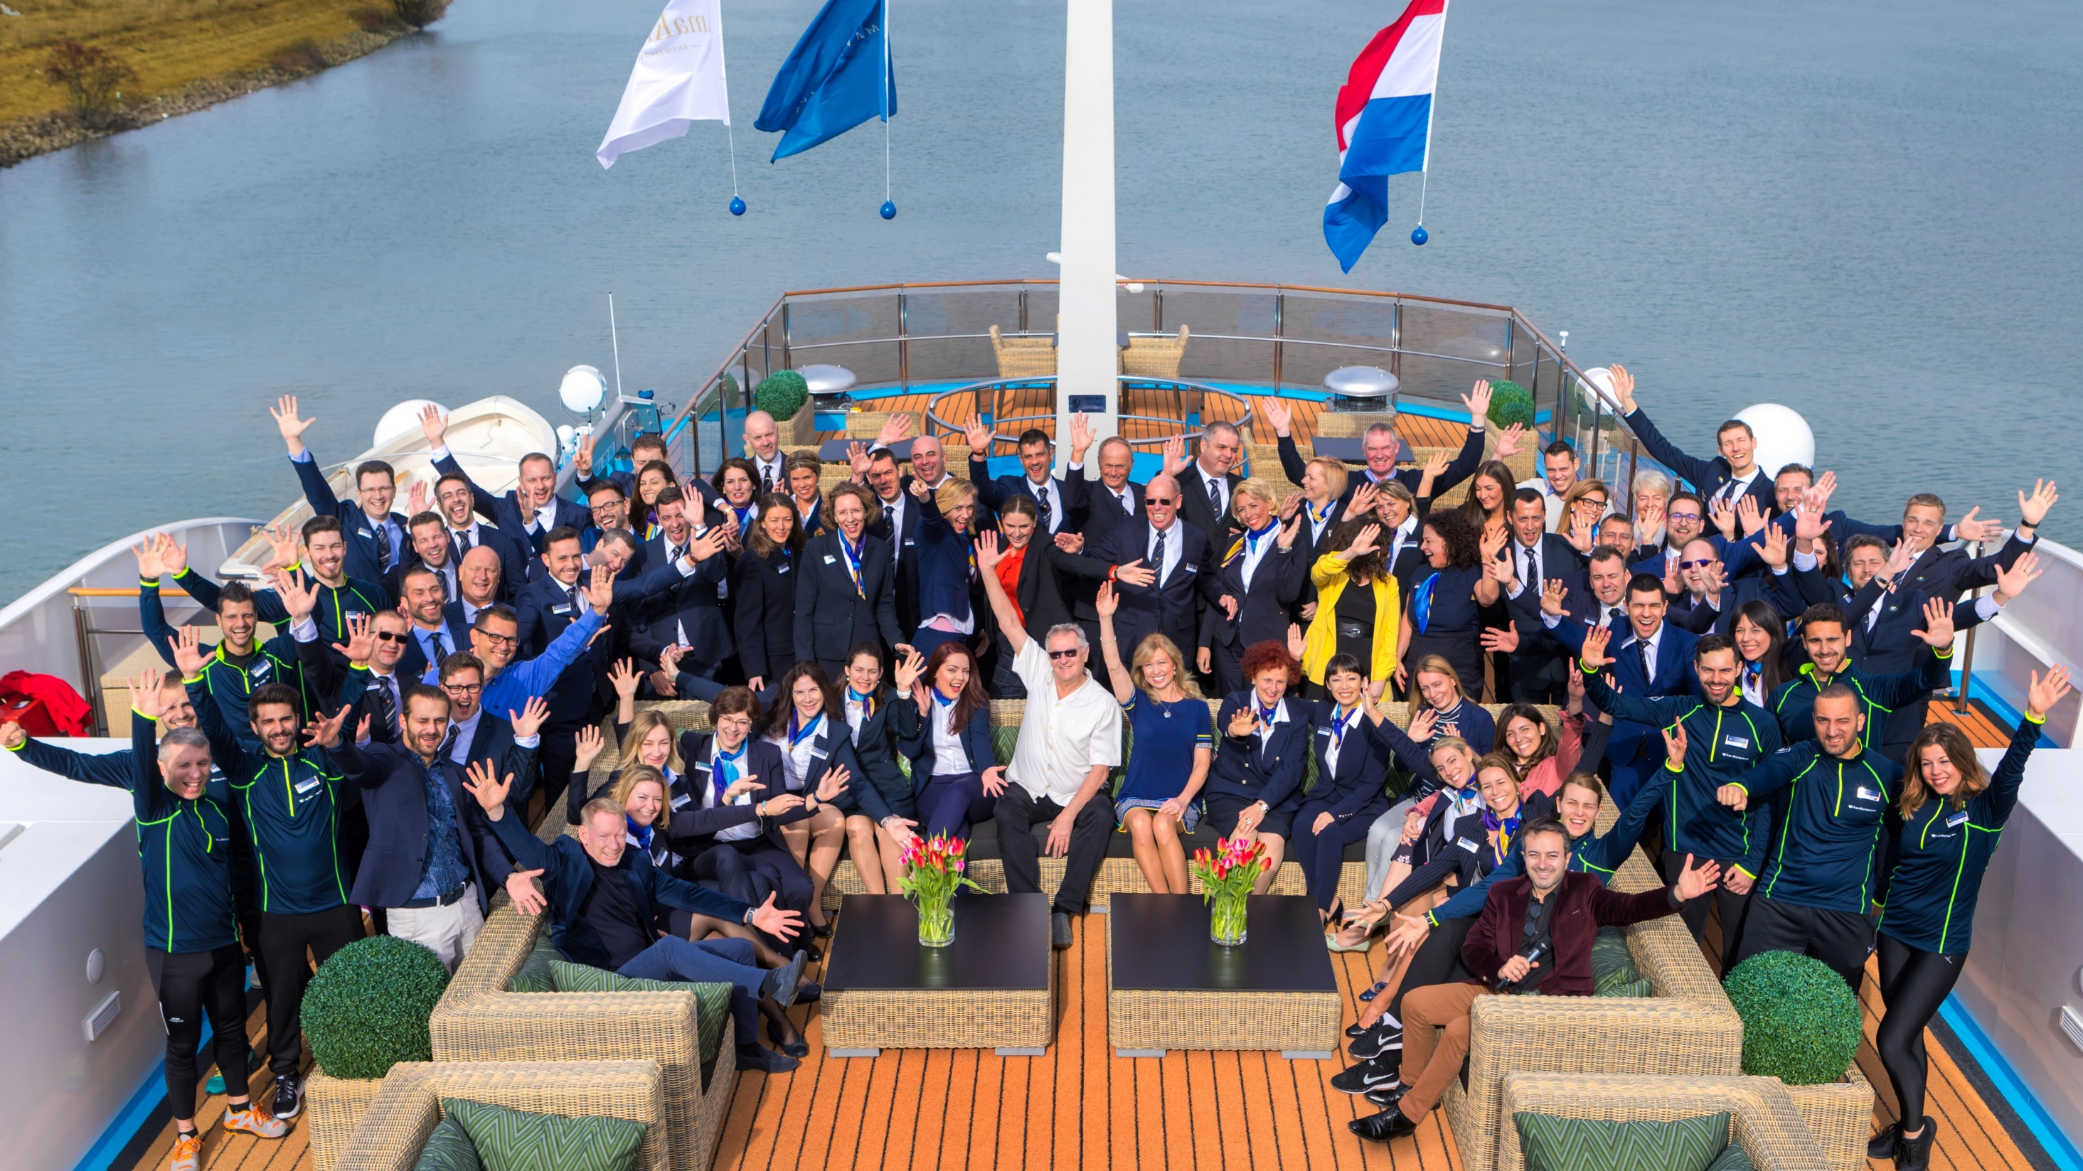

97%
FROM TRAVEL ADVISORS
More Than A Supplier
Your Partner
Notes:
We are more than a supplier. We are your partner.
We have no direct strategy and 97% of our business comes from you, our values travel advisors.

Slide 16
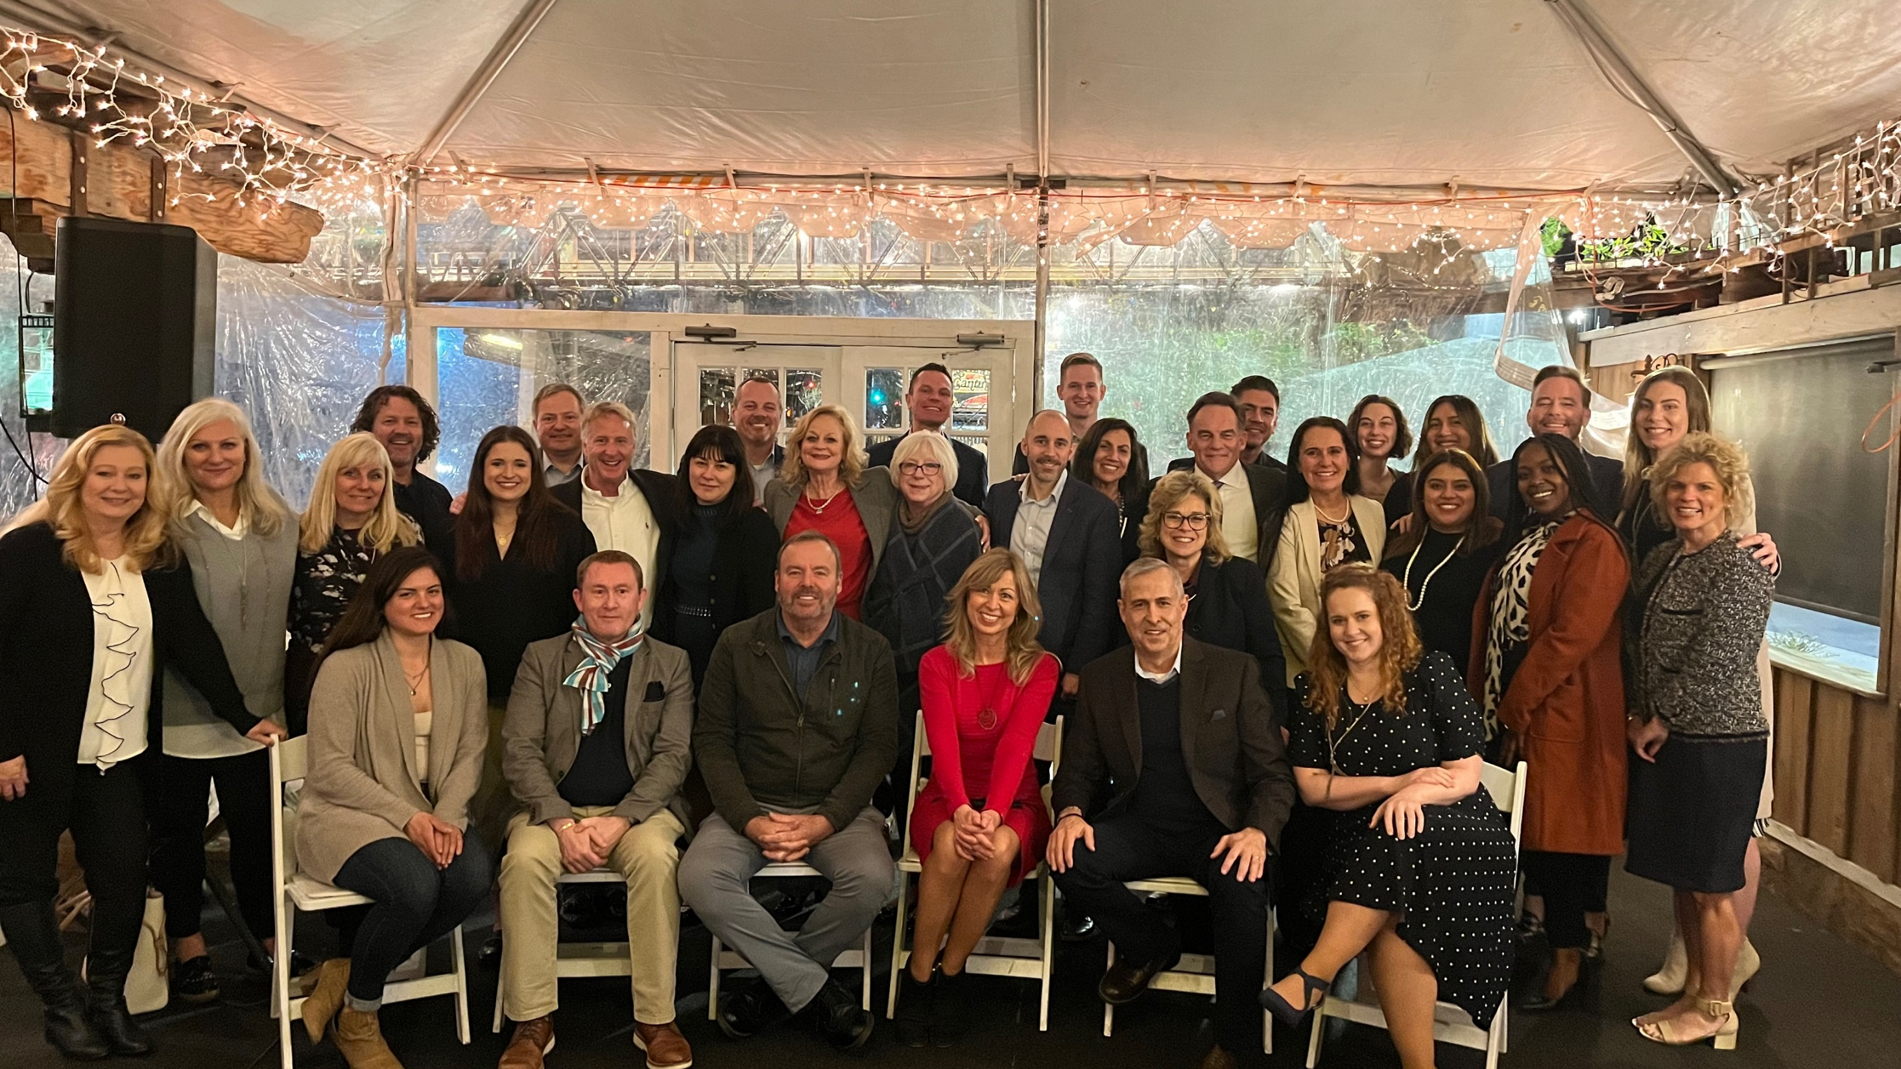
YOUR DEDICATED
Sales Team
Notes:
Alex: Connect with your local BDM
Schedule a cruise event!!
They are your business partners

Slide 17
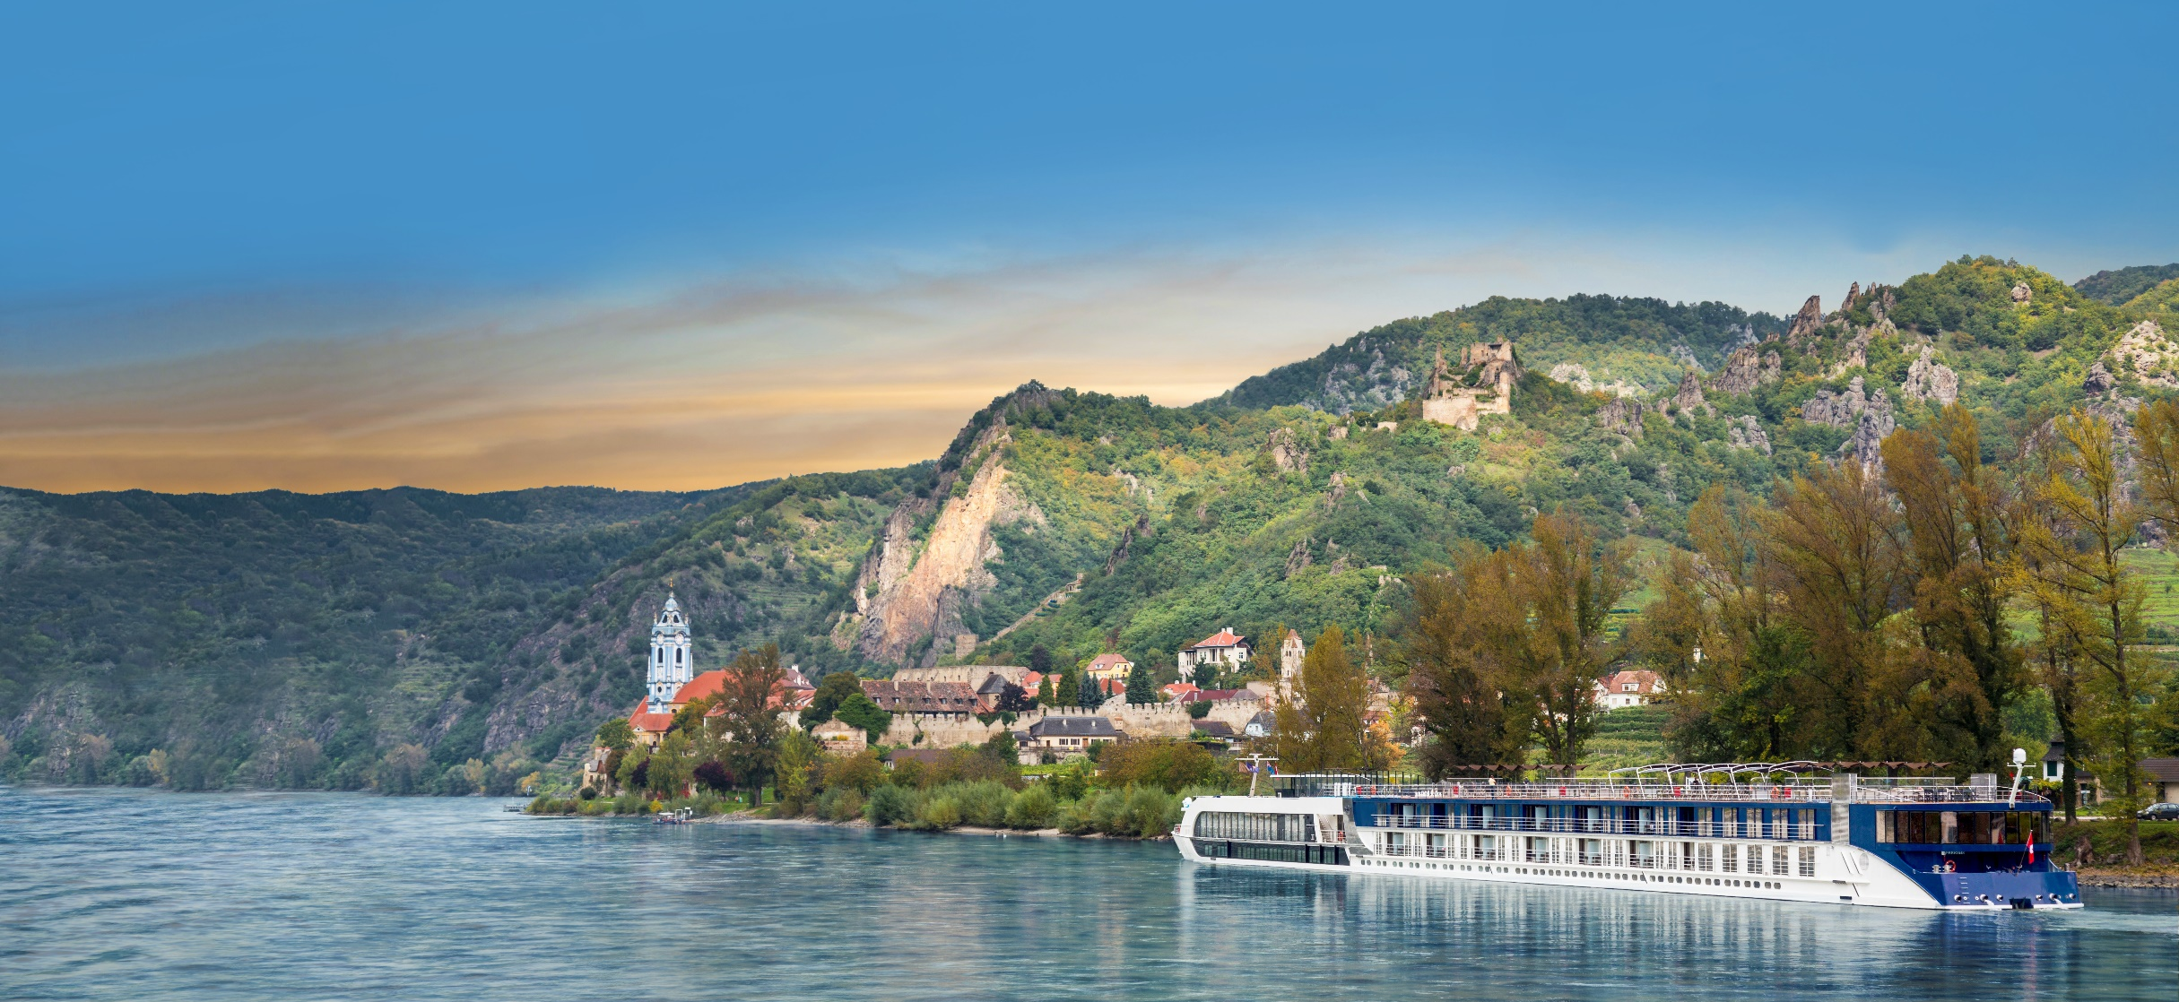


SAVE 20%
on select 2023 and 2024 Europe and Mekong river cruises
Valid for reservations made by December 31, 2023
Combinable with Loyalty Savings, Future Cruise Benefits and Europe AirPlus Dates
Terms & conditions apply
Notes:
For a limited time, save 20% on select 2024 and 2024 Europe & Mekong river cruises! (Valid for reservations made by December 31, 2023
Applicable to all categories based on double occupancy
Single Supplement of 20% is available for solo travelers only; not combinable with any other offer and excludes A+, AA+, SA, SB and suites.
Port charges, upgrades, transfers, land packages, gratuities and airfare are additional.
Combinable with Loyalty Savings, AirPlus fixed rates, FCB Program

Slide 18

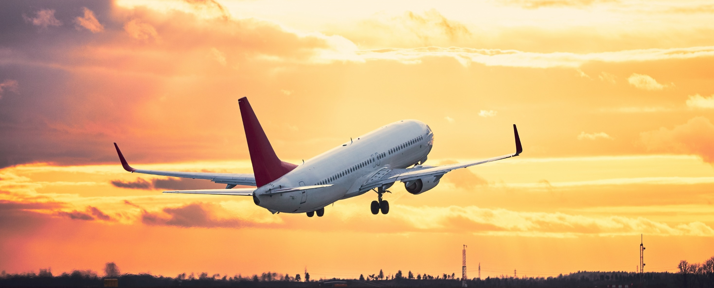
AMAWATERWAYS AIRPLUS
Your clients can enjoy flat air rates on select Europe 2023 & 2024 departures
Economy Air: $899/C$1,099
Premium Economy Air: $2,299/C$2,999
Business Class Air: $4,299/C$4,999
Valid for reservations made by December 31, 2023
Terms & conditions apply
Notes:
To make our river cruises more accessible, we’re offering your clients these incredible flat rates on their airfare for select Europe 2023 & 2024 sailings ALL GATEWAYS!
Rates (per person):
ECONOMY AIR - $899/C$1,099
PREM ECONOMY AIR - $2,299/C$2,999
BUSINESS CLASS - $4,299/C$4,999
The AirPlus Economy Air is bookable on the OBE however for Premium Economy and Business Class, you will have to call into Reservations.

Slide 19
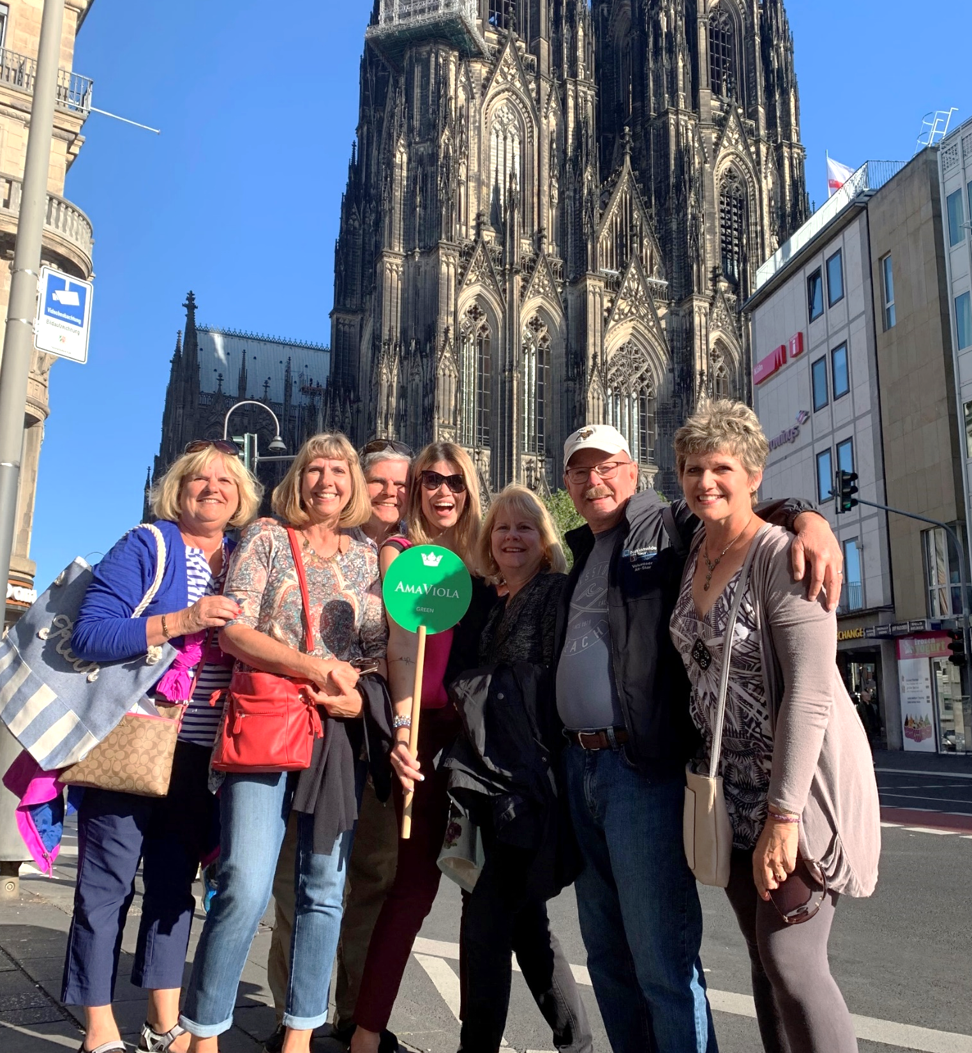

GROUP INCENTIVE
Travel Advisor Upfront Stateroom
Earn a Travel Advisor Upfront Stateroom with new group bookings on select 2024 and 2025 Europe & Mekong River cruises
Valid for new group contracts signed & deposited by December 31, 2023
Upfront Stateroom is based in a Category E for Europe and Category C for Mekong
Terms & conditions apply
Notes:
SLIDE 21: Group Incentive (Extended!)
Alex: Travel Advisor Upfront Stateroom – limited time offer!
Applicable to new group contracts made by December 31, 2023
A minimum of 5 double occupancy bookings must be booked within the group (standard group policy)
Offer applies to select 2024 and 2025 sailings for Europe and Mekong
Upfront Stateroom is based in a Category E for Europe and Category C Mekong
Upgrades available at 50% of brochure fare within 60 days of embarkation date; subject to availability.
TA can opt to pay full upgrade price if reserving stateroom prior to 60 days
If group falls under 5 staterooms by embarkation date, TA Upfront Stateroom reverts to full retail price.
The TA Upfront Stateroom is limited to 1 per Travel Agency on any one sailing and is only applicable to the stateroom the travel advisor will be occupying
When applicable, Group Amenity Points can be redeemed for $50 onboard credit, a bottle of wine or a box of chocolates per stateroom; confirmed Travel Advisor escort at a travel advisor rate cannot be redeemed in addition to the TA Upfront Stateroom offer

Slide 20
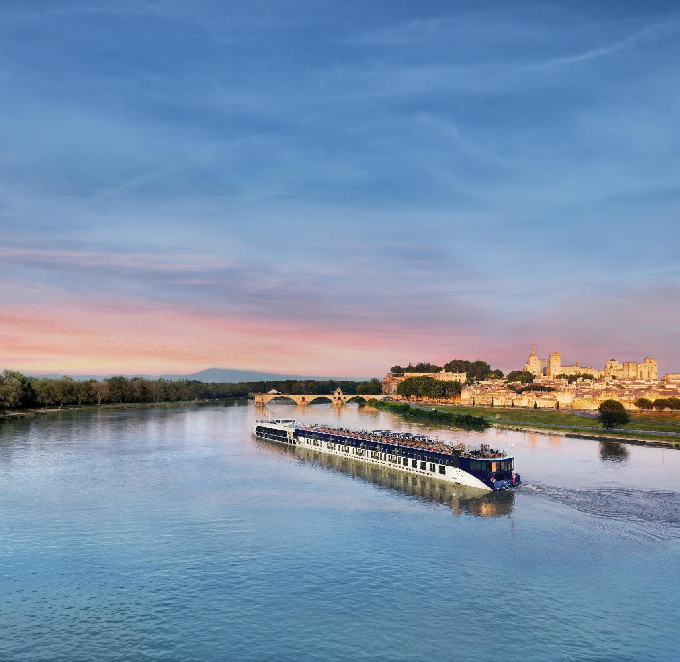



AFFLUENT TRAVELERS
exclusive benefits
2023 & 2024 AMENITY PROGRAM
Up to $300 Onboard Credit per stateroom on
sailings in Europe and Asia
2024 AMAMAX PROGRAM
Up to $300 Onboard Credit per stateroom plus
25% enhanced commission on sailings in Europe and Asia
Terms & conditions apply
AVIGNON, FRANCE
Notes:
2023 Travel Leaders Network Amenity Program: 50 dates
Terms & Conditions: All prices listed are in USD. Dates listed are embarkation dates. Offer valid on new bookings for the 2023 departures listed above, valid from April 15, 2022 through sailing date. Rates are per person for cruise only based on double occupancy in a Category E (Mekong - Category C). Optional land programs, port charges, gratuities, visas and airfare are additional; please ask for details. Onboard credit amounts are $300 per stateroom ($150 per person), based on double occupancy (solo travelers receive half). Offer is combinable with current promotions and is applicable to FIT and Group bookings. Some restrictions may apply. Availability is limited on each cruise and the offer is subject to change or discontinuation without notice. OBCTLN. CST#2065452-20. V22NOV30SI
2023 Travel Leaders Network Block Program: 50 dates
Terms & Conditions: Contact AmaWaterways directly and identify yourself as a Travel Leaders Network advisor and ask for the exclusive Block Program. *Must ask for Promo Code TLNBLOCK at time of booking in order to receive. Offer valid on new FIT bookings made from April 15, 2022 through sailing date on Travel Leaders Network 2023 Block dates only. Dates listed are embarkation dates. All prices listed are in USD. Rates are per person for cruise only based on double occupancy in a Category E (Mekong - Category C). Block program is combinable with current promotional offers available at the time of booking; not combinable with Travel Leaders Amenity and Travel Leaders Distinctive Voyages programs; not combinable with AMEX Card Benefit programs. Block offer is applicable to FIT bookings only and not applicable to groups. 25% commission is calculated on the cruise fare only; land, air and insurance will be at standard commission rates. Onboard credit amounts are $300 per stateroom ($150 per person), based on double occupancy (solo travelers receive half). Optional land programs, port charges, intra-Asia and international airfare are additional; please ask for details. Availability is limited on each cruise and the offer is subject to change or discontinuation without notice. AmaWaterways reserves the right to correct any errors or omissions at any time. CST#2065452-20. V22APR05SI
2023 Travel Leaders Network Distinctive Voyages Program: 10 dates
Terms and Conditions:
Dates listed are embarkation dates. Rates listed are per person in USD for cruise only; Port charges, stateroom upgrades, optional land programs, gratuities and airfare are additional; please ask for details. Offer is valid on new bookings starting April 1, 2022 through sailing date and is combinable with current promotional offers available at the time of booking. Offer is not combinable with Travel Leaders Block Program or Travel Leaders Amenity Program and is not applicable to groups. Travel Leaders Network guests receive an exclusive shore excursion and cocktail reception on the select dates listed above. *A minimum number of 5 staterooms/10 guests is required for the exclusive shore excursion and onboard cocktail reception. If the minimum is not met, guests will receive $150 USD per person onboard credit and a bottle of wine in lieu of the private tour and cocktail party. Offer is capacity controlled and subject to modification, reduction or withdrawal without notice. Registration as a seller of travel does not constitute approval by the State of California. CST#2065452-20. V22APR13SI

Slide 21
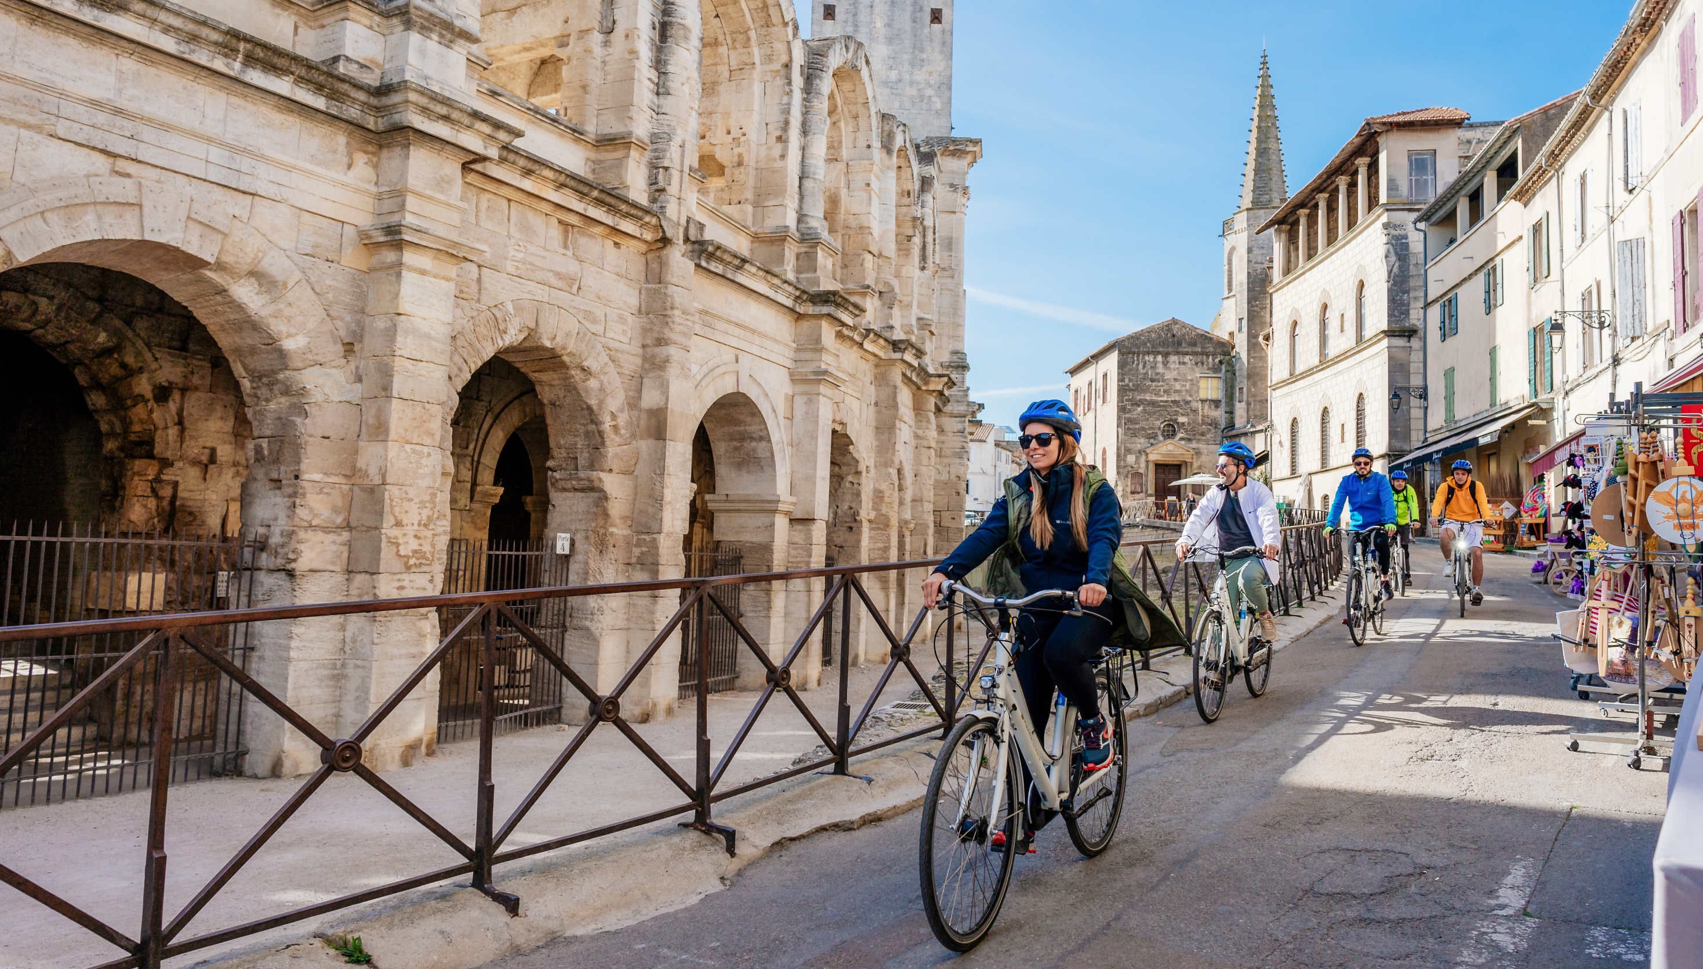

OUR STORY CONTINUES…
ARLES, FRANCE

